Slide 1
Usage Statistics for Electronic Resources: Beyond the Alphabet Soup
Denise D. Green, Millikin University
First presented March 11, 2013

Slide 2
Usage Statistics Introduction
Definitions of search, document used, etc.
COUNTER, SUSHI, JISC, etc.
How vendors use these terms and standards
Why bother to collect such messy data? How to use?
Questions
Notes:
Goals for today’s webinar.
You will know definitions, what the “soup” of acronyms mean, vendor details, why bother?

Slide 3
Definitions from Counting Online Usage of Networked Electronic Resources (COUNTER) :
Search- specific intellectual query, typically equated to submitting the search form of the online service to the server. (click on “search”.)
Session- user activities that typically starts when a user connects to the service or database and ends by terminating activity by exit, logout or timeout. Some vendors label a session as a “visit” or “visitor” to an electronic resource.
Full text document used- Variety of ways to count. Example PDFs or html documents used, opened or downloaded for journal articles, book sections or entire ebooks. Some multimedia resource vendors keep track of music clips used, images shown or videos streamed, while other vendors do not distinguish separate meaningful units of content and instead compile numbers of “web pages” viewed.
Notes:
Counting Online Usage of Networked Electronic Resources (COUNTER) standard definitions. While vendors have a variety of definitions of these activities, the majority uses the COUNTER standards’ definitions. Started in 2002 by vendors, consortia staff and librarians looking for standard definitions for e-resources usage.

Slide 4
Definitions from Counting Online Usage of Networked Electronic Resources (COUNTER) :
Search- specific intellectual query, typically equated to submitting the search form of the online service to the server. Examples.

Slide 5
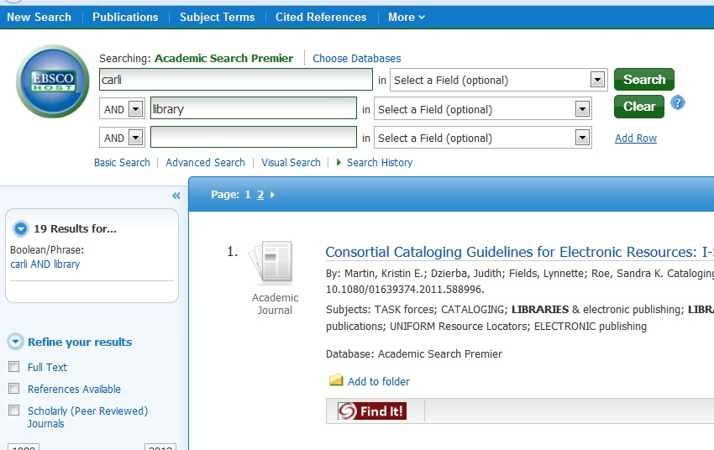
Notes:
You enter a keyword(s) and click on “Search” and one more search is counted in usage stats.

Slide 6
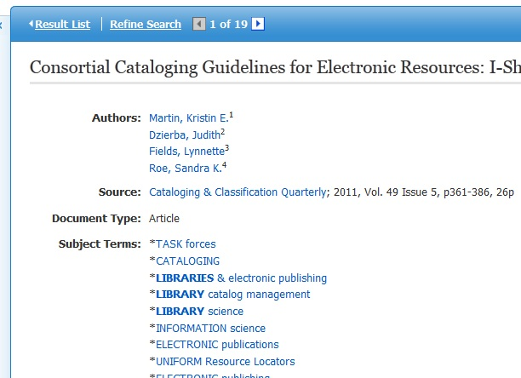
Notes:
If you click on author name or subject, a new search is initiated and one more added to stats.

Slide 7
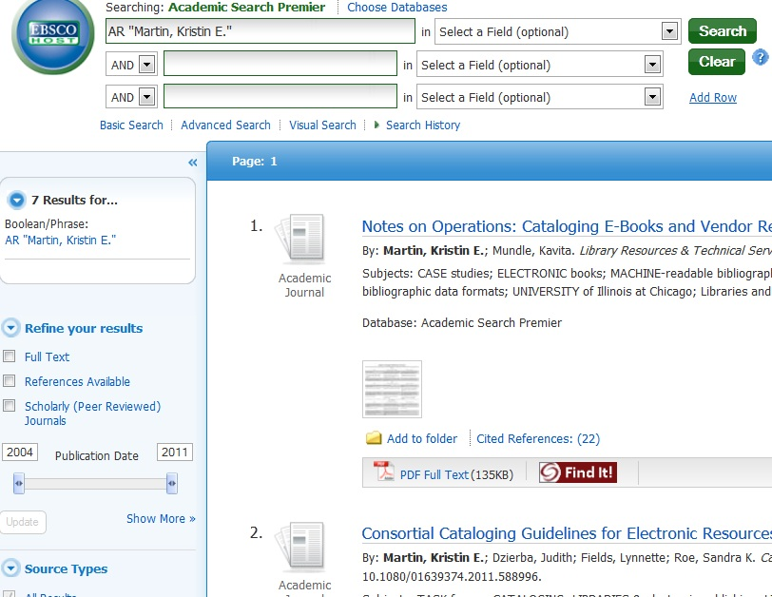

Slide 8
Definitions from Counting Online Usage of Networked Electronic Resources
(COUNTER) :
Session- user activities that typically starts when a user connects to the service or database and ends by terminating activity by exit, logout or timeout. Some vendors label a session as a “visit” or “visitor” to an electronic resource.
Turnaways / Access Denied- unsuccessful log-in to an electronic service due to exceeding the simultaneous/concurrent
user limit allowed by the license.
Notes:
The ratio of sessions to searches depends on your users’ searching choices, nature of resource, etc. Some vendors keep track of “turnaways”.
Project Counter glossary at http://www.projectcounter.org/r4/APPA.pdf

Slide 9
Definitions from Counting Online Usage of Networked Electronic Resources (COUNTER) :
Full text document used/ content unit used - Variety of ways to count.
Example PDFs or html documents used, opened or downloaded for journal articles, book sections or entire ebooks.
Some multimedia resource vendors keep track of music clips used, images shown or videos streamed.
Other vendors do not distinguish separate units of content and instead compile numbers of “web pages” viewed.
Notes:
Widest variation among vendors counting content used, IMHO.

Slide 10
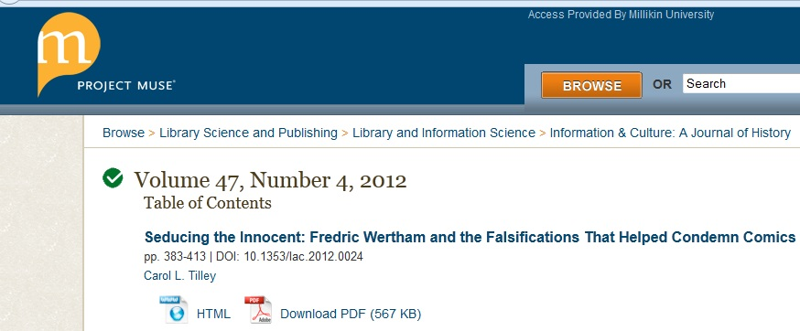
Notes:
Click on “Down load pdf” or “html” and document will open. One more doc used added to usage stats.

Slide 11
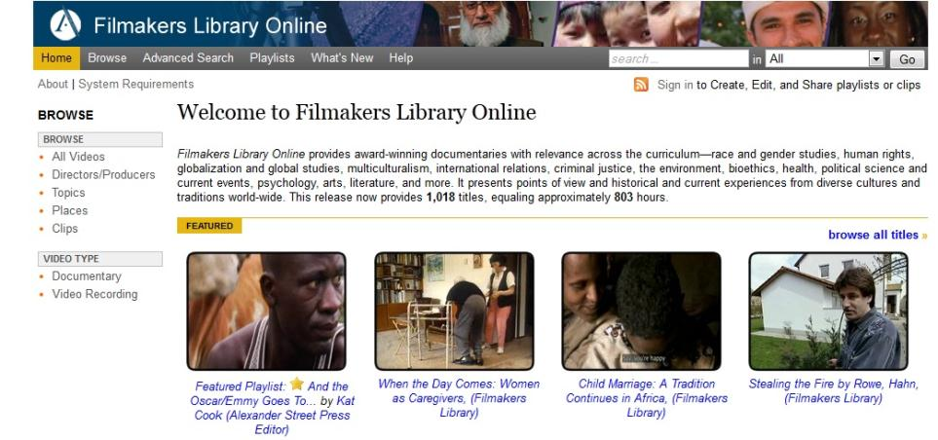
Notes:
Similarly here, click on film’s name and get next slide and one more added.

Slide 12
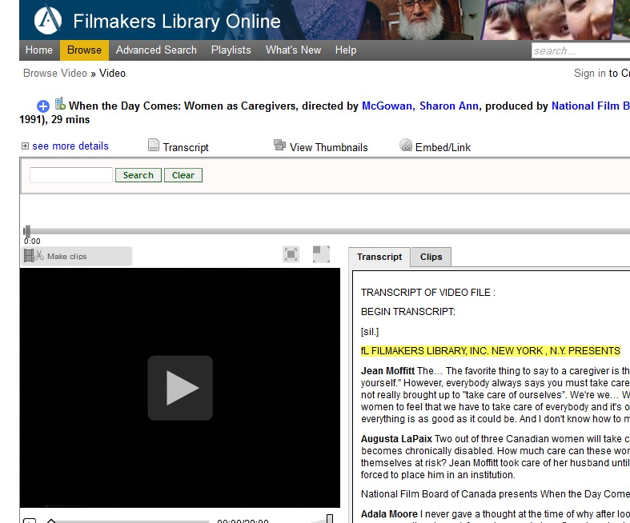
Notes:
Most e-resources don’t measure level of usage. Could look at 1 second or 29 minutes of this documentary. Or if text document read a small amount or whole text.

Slide 13
Standards: COUNTER - http://www.projectcounter.org/
Notes:
Source of some text from previous slides.
History at http://www.projectcounter.org/about.html

Slide 14
Standards: SUSHI Standardized Usage Statistics Harvesting Initiative- http://www.niso.org/workrooms/sushi
Notes:
Standard for setting up automatic harvesting and compilation of usage stats by various programs such as SFX’s UStat or JISC portal.

Slide 15
Standards: JISC Journal Usage Stats portal: http://jusp.mimas.ac.uk/
Notes:
Joint Information Systems Committee (JISC), a UK library org. Their portal one of attempts to streamline stats collection.

Slide 16
Why collect? How use in your library?
Notes:
Pause for questions on definitions. Why bother? Inherently messy data and time consuming to gather and edit.

Slide 17
Evidence based Renewal Decisions or
Expanding subscription decisions
Busy/ slower times of year
Collection studies- subject interests growing or shrinking among your patrons
Other Benefits
Notes:
Some libraries try to have a minimum. For ex., don’t continue subscription of e-journal if less than 10 articles a year used. Or if cost per search over X amt.
Ex. simultaneous users decisions (increase or cut sim users) based on “turnaways”.

Slide 18
Points to ponder:
Usage statistics are not the whole story of how or why an eresource is used.
Vendors vary in definitions.
Eresources vary in format- ex. Html/pdf, free/paid, years, etc.
Subjects vary in usage patterns
Ups and downs of course offerings
Time lag in collection anywhere from hours to a month

Slide 19
Points to ponder:
Serials are still crazy- title/ISSN changes, publisher changes, split/merge, etc.
Accreditation or document delivery factors
Platform/ New interface affects usage in itself and in how it interact with discovery products
Notes:
More factors effecting usage data. Esp. at journal title level.
May have to keep some titles regardless due to factors not at all related to usage such as accreditation or “very hard to get by ILL” etc.
Discovery products can inflate or depress usage depending on how vendor interacts with them & how set up.

Slide 20
Summary
Definitions
Why collect and use the usage stats
Vendor Examples
Come to CARLI event in March 25, 2013.
Notes:
Goals covered today.

Slide 21
Resources for more info
Bucknell, Terry. Garbage In, Gospel Out: Twelve Reasons Why Librarians Should Not Accept Cost-per-Download Figures at Face Value. Serials Librarian: 2012. Vol. 63, Iss. 2. pp. 192-212.
Fleming-May, Rachel A. & Jill E. Grogg. Practitioner Responses on the Collection and Use of Usage Statistics. Library Technology Reports; Sep2010, Vol. 46 Issue 6, p28-34.
Schufreider, Bob & Sion Romaine. Making Sense of your Usage Statistics. Serials Librarian; Jun2008, Vol. 54 Issue 3/4, p223-227
This slide deck and related resources will be on CARLI Web site.

Slide 22
Questions? Comments?

Slide 23
Thank you! Denise D. Green Staley Library 1184 West Main Street Millikin University Decatur, IL 62522 ddgreen@millikin.edu

