Slide 1
PREPARING FOR Resource Description and Access (RDA)
Cathy Salika
Nicole Swanson
CARLI Annual Meeting, Nov 9, 2012

Slide 2
Impact of RDA
A brief intro to RDA
Dates and deadlines
Impact on patrons and Public Services
Impact on Technical Services
CARLI training offerings
Brainstorming your “To Do” List

Slide 3
Intro to RDA
The biggest change to cataloging rules since AACR2 in 1978
Speaks to many kinds of metadata, not just the contents of our catalogs
Has the potential to facilitate more seamless integration of the systems in your library
  ILS
  Institutional Repositories
  Digital Collections
  Archives
Notes:
RDA stands for Resource Description and Access
replaces AACR2
sanctioned by ALA and the national libraries, as AACR2 was

Slide 4
Intro to RDA
In the ILS of the present
We’ll still use MARC
We’ll still share bibliographic data
We’ll have a mix of AACR2 and RDA records
In the ILSes of the future, potentially
New ways of navigating among manifestations of a work
New ways of navigating among systems
Alternatives to MARC encoding

Slide 5
Intro to RDA
For MARC records in the ILS
Better coding of physical media
Fewer abbreviations
Potentially more name entries on a bibliographic record
New form of entry for some name entries
Notes:
Two big themes behind this is improved readability of the catalog data and more sensitivity to media.
Maybe you are underwhelmed by the changes and wonder what the fuss is about.
The power of RDA is
… across many platforms.
… in “the next ILS”
… in new encoding schemas

Slide 6
Dates and Deadlines
There are already RDA bib records in WorldCat and our local catalogs, created during the pilot phase.
There are already RDA authority records in our local catalogs and I-Share.
The national libraries will fully implement RDA by March 31, 2013.
They have said that each library may decide for itself when to begin to implement RDA.
But RDA records will become more prevalent after March.
Notes:
AACR2 and RDA records coexist pretty well.
You do not have to do a full retrospective conversion.
You may want to do some authority clean up.
More on that in a moment.
As AACR2 records become more scarce, you’ll need to make the switch.
CARLI may have some best practices to recommend.

Slide 7
Impact on Patrons and Public Services
Because CARLI has frozen development on Web Voyage Classic, RDA raises some issues.
Limits by medium will work less well for RDA records.
Heading searches will find some AACR2 heading that are now unauthorized forms.
CARLI is making changes to VuFind to accommodate RDA.
It will take advantage of the improved media encoding.
It will display some of the new MARC fields.
AACR2 and RDA headings will appear as hot links.
Notes:
These next few slides are mostly for I-Share libraries,
But the rest of you may recognize similar issues in your systems.
Web Voyage Classic has been frozen for several years.
These issues are not insurmountable, but you might want to revisit the decision to stay with WV Classic.
It’s good that both AACR2 and RDA headings will be hot links, but there are no crosswalks between them.
This will, in a few cases, reduce recall.
A couple examples…

Slide 8
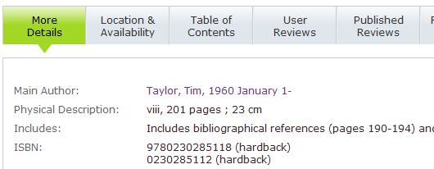
Impact on Patrons and Public Services
An RDA bib:
Notes:
There are 2 authors named Tim Taylor, so they are distinguished by their birth dates.
RDA requires that the month be spelled out.
When you use the hot link in the More Details display, VuFind does all keywords in author fields.
so it doesn’t find earlier versions of the heading unless “January” in in another author heading.

Slide 9
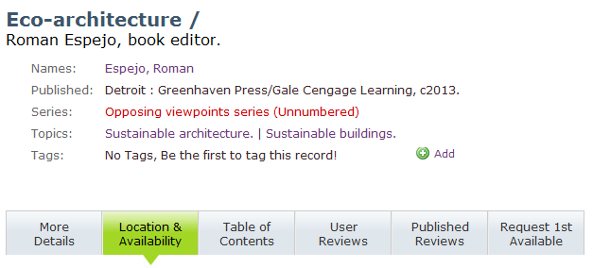
Impact on Patrons and Public Services
Another RDA bib:
Notes:
Here’s an example of a series heading.
RDA requires the “unnumbered”.
VuFind searches the heading as a phrase.
So you don’t get some older volumes in the series.
These are not very common changes.
I had to dig to find them.
Most AACR2 headings will be fine in RDA.
But you may want to do some authority work to improve the recall of your searches.

Slide 10
Impact on Technical Services
New cataloging rules!
Training!

Slide 11
CARLI-Provided Training
For public services and copy catalogers
3 recommended webinars from ALA/ALCTS
An ICAT webinar on VuFind changes and the impact of authority control on searching
An ICAT webinar on RDA encoding in I-Share and approaches to authority maintenance
No charge
Available this fall & winter
Recorded
Notes:
Many of your libraries have begun training already.
Great. Just come for the I-Share-specific issues.
We don’t mind if you want to get training elsewhere
but we’re trying to provide a good, basic package of training the suits most libraries.
The three ALCTS sessions are better for catalogers than for public services staff.
But the ICAT sessions will be useful to all kinds of library staff.

Slide 12
CARLI-Provided Training
For original catalogers
A day-long in-person training on RDA
Probably offered twice
Including details about various media types
No charge
Planned for Spring, 2013
Notes:
Original catalogers will need more training after the webinars.

Slide 13
CARLI-Provided Training
On the CARLI web site
A wiki for sharing information about RDA training
http://wiki.carli.illinois.edu/index.php/RDA_Training_Opportunities_List
Soon to be replaced by a new RDA Resources page
  Books & articles
  Webinars
  Training opportunities

Slide 14
What’s on Your “To Do” List?
Notes:
Factors for deciding when to implement RDA
Training plans
Updating BI

Slide 15
Thank you!
Reach us at
support@carli.illinois.edu
217-244-7953
866-904-5843

