Slide 1
Customizations

Slide 2
User Accounts
LDAP support
Email lookup
More secure bind accounts
Admin cancellations email the user

Slide 3
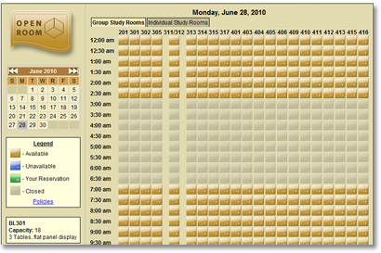
appearance

Slide 4
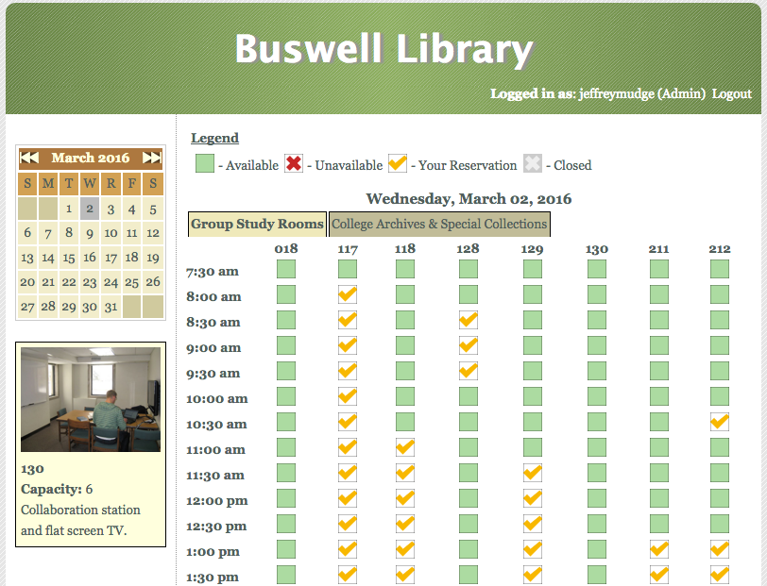
Appearance

Slide 5
Reporting
Default reports are reservation focused
Added a report for total hours reserved per room per month

Slide 6
Security
Updated deprecated database functions (mysql to mysqli)
Improved processing of requests (escaping POST variables)
Added better error messages

Slide 7
Administration
Challenges
  It’s ugly ¯\_(ツ)_/¯
  Tedious to change hours
Improvements
  Added simple ways to remove old hours
  Added simple ways to apply default hours to multiple days per room per group

Slide 8
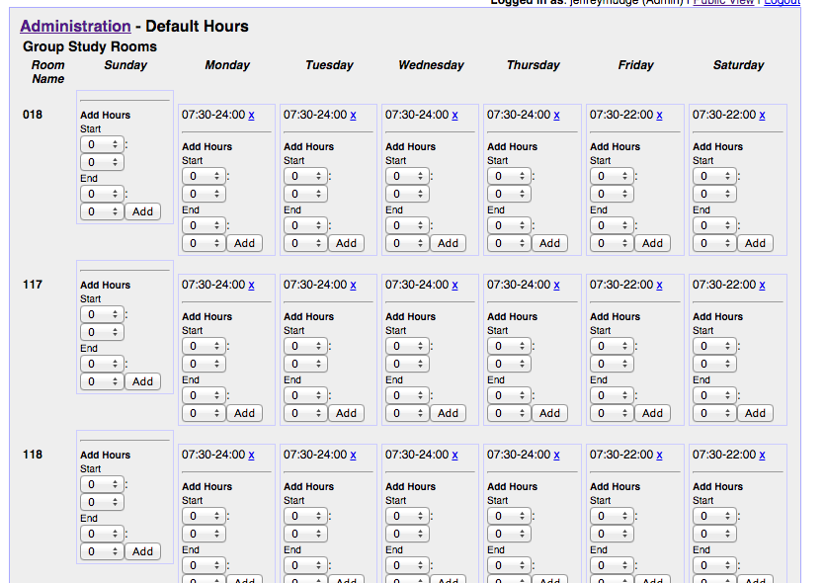

Slide 9
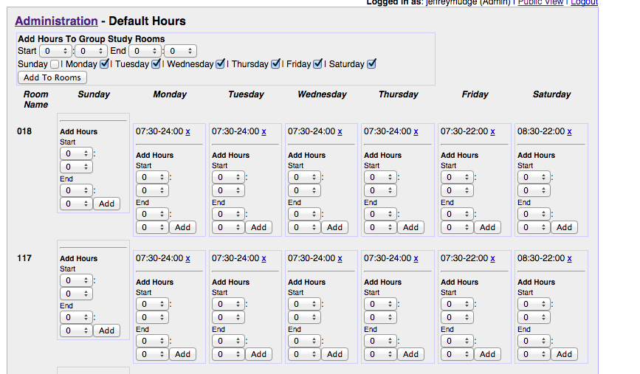
New Interface

Slide 10
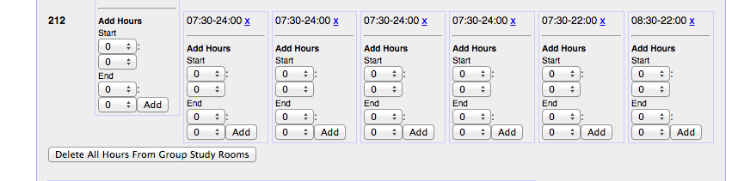

Slide 11
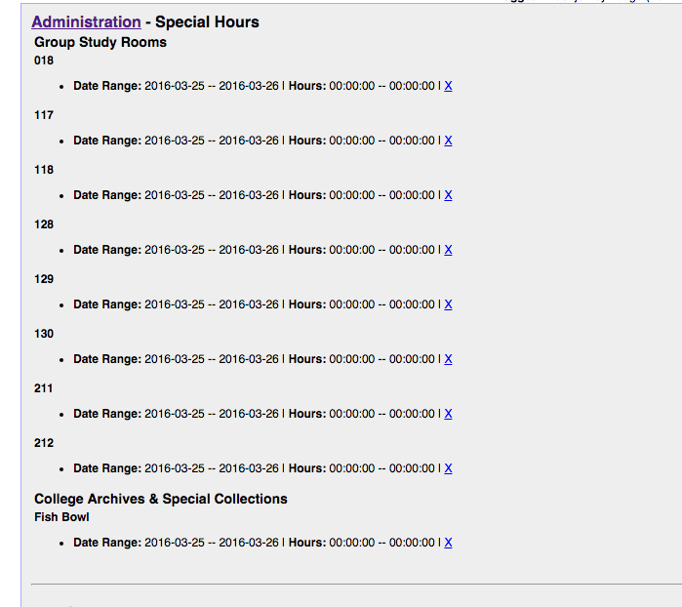

Slide 12
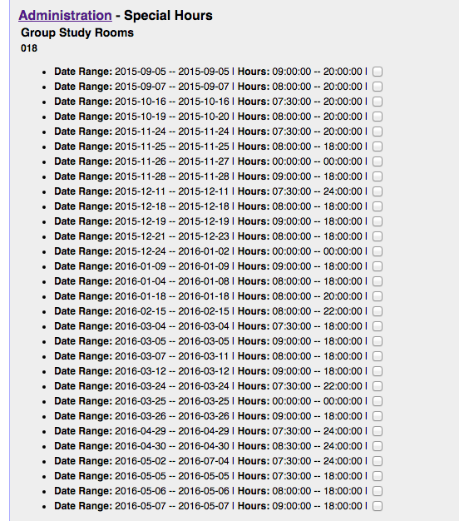
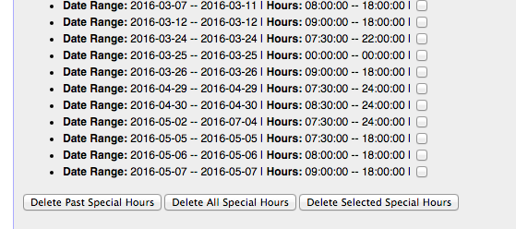

Slide 13
Questions?
Jeffrey.Mudge@wheaton.edu

