Slide 1
Wideo
CARLI Public Services
Open House
March 11, 2016

Slide 2
Let’s take a look
Wideo introduction
Milner Library example

Slide 3
In general
wideo.co (not .com)
easy, clean interface
media library and templates
  templates styles range from tutorials to presentations to invitations
start from scratch (and even create your own template)

Slide 4
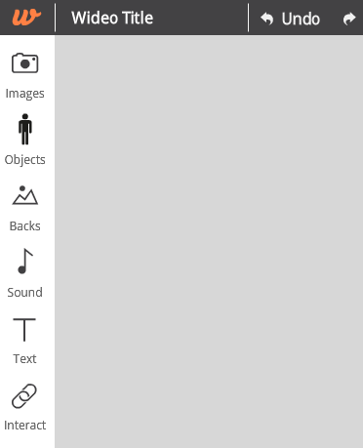
Types of Media
Images
Objects
  Animations
  Icons
  Shapes
Backgrounds
Sound
  Background music
  Upload voiceover
  Upload your own music
Text and Font
Interactive elements
  Buttons
  Forms
  Email entry

Slide 5
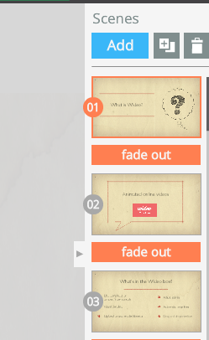
Scenes aka Slides in PowerPoint
Add and delete scenes
  Library of scene types
  Animated elements
  Customizable
Transitions
Re-order slides

Slide 6
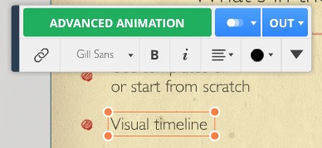
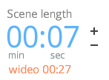
Timeline and Slide Objects
Adjust time and placement of objects
  Extend or shorten
  Slide along scene (slide) ruler
  Adjust type of animation
  Fade in / fade out
Explore objects
  Grouping / ungrouping
  Add animations
  Adjust individual elements
Adjust entire scene length

Slide 7
Things to consider
30 second time limit on videos with free account
wideo tutorials and support
Sharing (with free account)
  Embedding only for websites
  Downloading unavailable
  Uploading to YouTube unavailable

Slide 8
Potential Uses
Tutorials
for students
for faculty
on website
Student employee training
Non PowerPoint presentations
Advertising
?

