Slide 1

I-Share is 35 Years Old:
Revisiting the 1980 Vision while Looking Ahead
Kristine Hammerstrand
CARLI Director of User Services
CARLI Annual Meeting
November 13, 2015
Notes:
Susan invited me to talk about the 35 year anniversary of I-Share.
I felt it needed multiple perspectives, library, state, consortium, grateful to have Dave, Carlos and Pat here to present.
We will go through twice each, sort of focusing on the past first, and then the present and future on our second rounds.
We will each tell you a bit about ourselves to let you know our context in the long history of this organization. But this is not a story about the 4 of us, it is about all of us.
There is much of our history we cannot tell in an hour, so we are focusing, to some extent, I-Share the oldest CARLI service, which is the 35 year old having the birthday.

Slide 2
About Me
1978 Grad student and GA at UIUC in Lib Sci, everyone on UIUC staff working on LCS migration & implementation
1979 MS in LS UIUC, hired at NIU in August
1980 Coordinating LCS training at NIU
1981 Asst. Head Automated Records, NIU
Hired by UI to be Library Systems Coordinator
1989 ILCSO staff consolidated in Urbana
2005 CARLI, new org., new title, Director of User Services
2015 Still here, where do the years go...

Slide 3
Why do we care about the past ?
We face challenges and changes--fiscal, technical, organizational…
– Our predecessors did as well
We don’t always agree on priorities
  Our predecessors didn’t either
We have a remarkably long history of cooperation in Illinois libraries that we should know and learn from

Slide 4
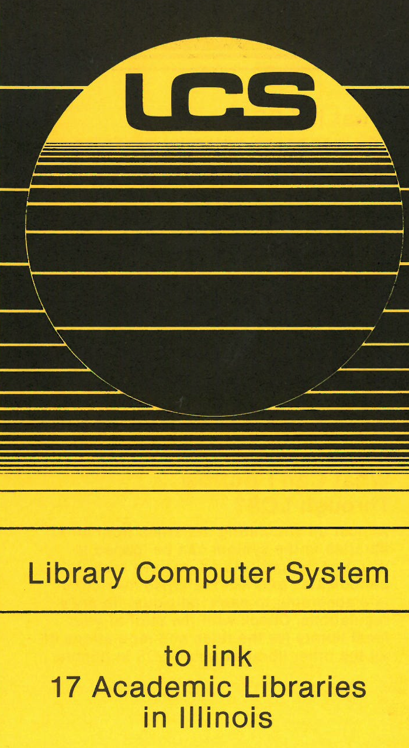

Several Names, but Same Concept: Resource Sharing
1978-1988
LCS
1988-2005 ILLINET Online
2005- Present
I-Share

Slide 5
In 1980, Our Illinois Predecessors…
Created a member driven governance organization, ILCSO, to advise the State on the management of the the new LCS shared system
Installed networking equipment in 15 libraries and 18 system headquarters to connect to LCS
Converted an uncounted number of bib records from catalog cards to LCS
Implemented a centrally run shared circulation and resource sharing system serving 15 libraries and growing
Launched ILDS, the statewide delivery system to ship materials between these libraries and library systems
Notes:
I’m going to focus on 1980.
It’s the year we are measuring this anniversary from.
And it was a remarkable year in terms of what was accomplished in IL libs.
Look at what our predecessors accomplished in 1980
READ SLIDE POINTS

Slide 6
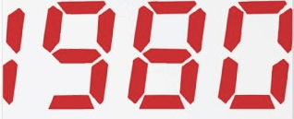
The Year is 1980
Let’s set the context
Notes:
Some of you may not remember 1980, some were’nt even around yet,
So here’s a few quick slides to set the 1980 context

Slide 7
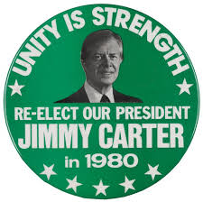
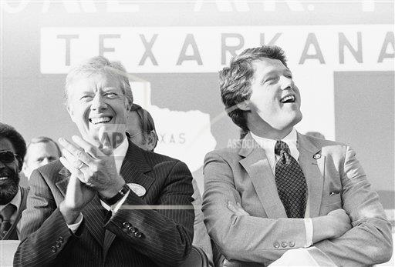
1980: President Jimmy Carter is running for re-election.
Notes:
Carter running for re-election (yes that is Bill Clinton)

Slide 8
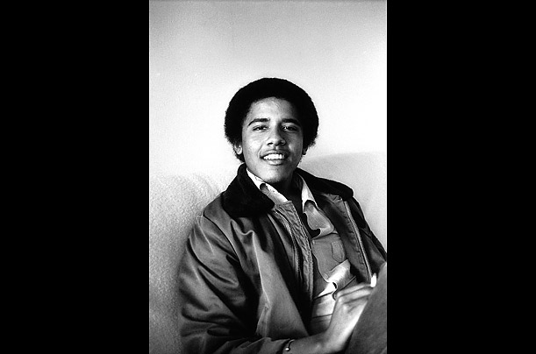
1980: President Obama is a college student, age 19
Notes:
Obama in college

Slide 9
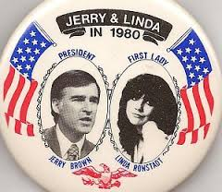
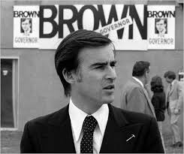
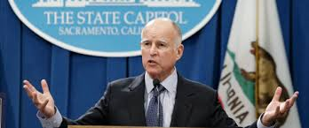
1980: Curiously, another 1980 Presidential candidate Jerry Brown is Governor of California, as he is (again) today, although no longer dating singer, Linda Ronstadt.
Notes:
Brown

Slide 10
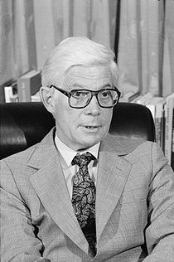
1980: This man from Rockford, Illinois also ran for President as an Independent. He got 6.6% of the popular vote. Can you name him?
Notes:
John B. Anderson of Rockford, got 6.6% of the vote in 1980

Slide 11

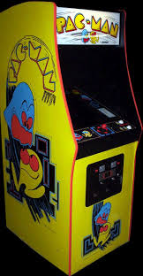
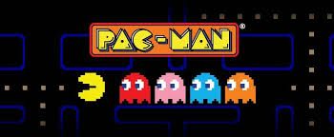
PAC Man was the hot new video game
Notes:
PAC Man was the hot new video game

Slide 12
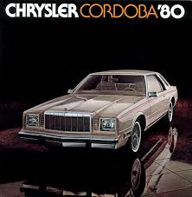
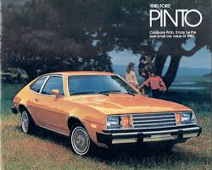
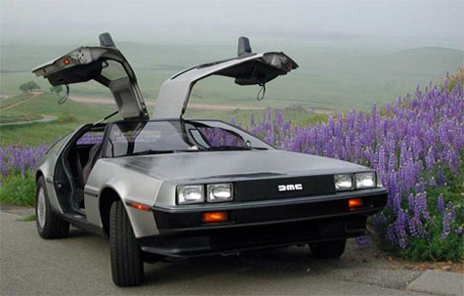
1980: Cars
Notes:
A 1980 Chrysler Cordoba, memorably advertised by Ricardo Montalban as being upholstered in “rich Corinthian leather,” cost $6,745. Last year for the Ford Pinto that sold for $3910.

Slide 13
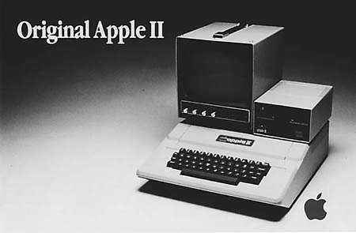
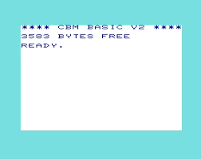
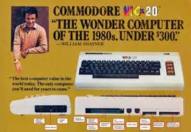
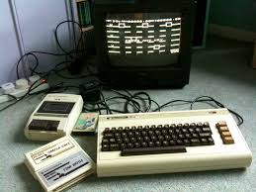
1980: You probably didn’t have a home computer. If you did, it may have had an optional tape drive.
A cassette tape drive.
Notes:
item 1980 postage stamp 0.15 bread 0.48
milk 1.60
A Commodore VIC-20 computer cost $299.95. It boasted a maximum of 5 KB of memory and didn’t include a monitor.
gas 1.03
car $5,413.00
income $11,321.00 house $86,159.00

Slide 14
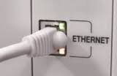

1980: Computer Networking—Ethernet networking was a brand new idea
September 30, 1980: Digital Equipment Corporation, Intel and Xerox introduce the DIX standard for Ethernet, IEEE 802.3, 10BASE5 the first implementation outside of Xerox Corporation, and the first to support10 Mbit/s speeds.
Notes:
The Internet was not in place yet, even the ethernet standard was just being written, and this is for 10base5, most of us are familiar with 10baseT
(LCS used TCAM, VTAM was another method)

Slide 15
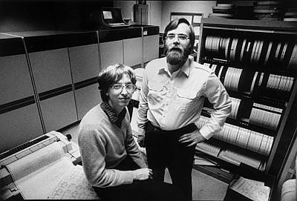
1980:
IBM hires Paul Allen and Bill Gates to create an operating system for a new PC.
The pair buy the rights to a simple operating system manufactured by Seattle Computer Products and use it as a template.
IBM allows the two to keep the marketing rights to the operating system, called DOS.
Notes:
Microsoft, Windows, did not exist, Gates and Allen were busy selling DOS to IBM

Slide 16
Libraries were concerned about their future in
Notes:
As now, librarians worried about the future of libraries, here’s a couple of citations that demonstrate these concerns

Slide 17
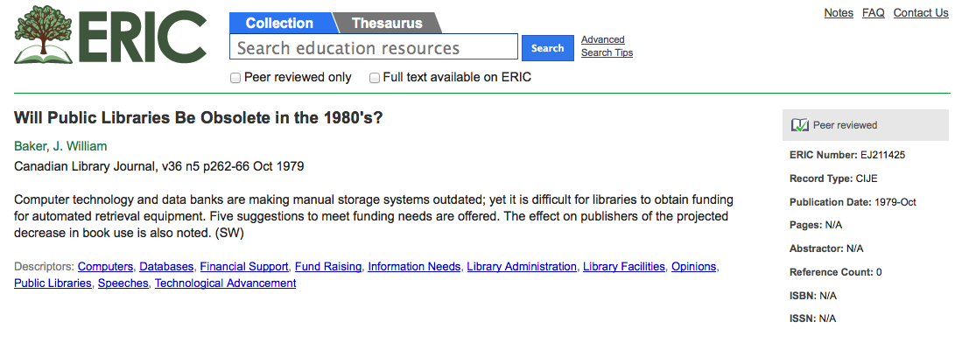

Slide 18
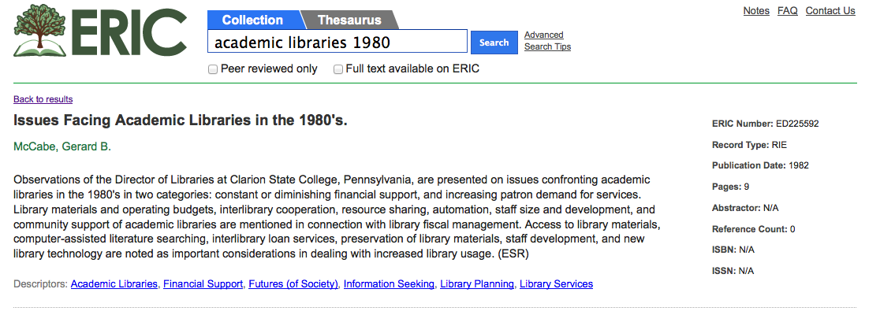

Slide 19
I-Share’s Origins
IBHE stated a vision in 1966 for finding a way to get the Illinois college and university libraries to cooperate through technology
LCS, Library Computer System software developed by IBM and Ohio State University in the early 1970’s
IBHE/IACRL joint committee selected LCS over other options for a shared system
And there was one individual who stood out among the many who played leading roles in this period of change…
Notes:
So, back to Illinois
How did we get started
Dave and Carlos both will cover some of this a bit as well…

Slide 20
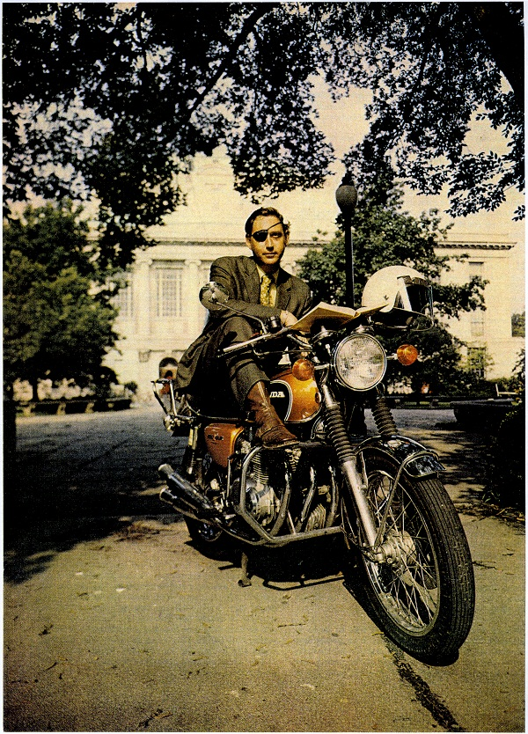
Meet Hugh C. Atkinson
Glen Ellyn, Illinois native
M.A. from Univ. of Chicago library school
Worked at Univ. of Chicago, SUNY
Library Director at Ohio State Univ. 1971-76
Library Director at UIUC 1976-1986
Led the effort to bring LCS to Illinois for a state-wide implementation
Died at age 53 in 1986
Memorialized in the ALA LITA Atkinson award recognizing innovation and risk taking, and by ILA in the Atkinson award recognizing long term impact in library cooperation
Notes:
Iconoclast, visionary, all-round larger than life character

Slide 21
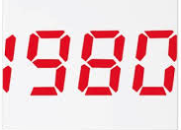
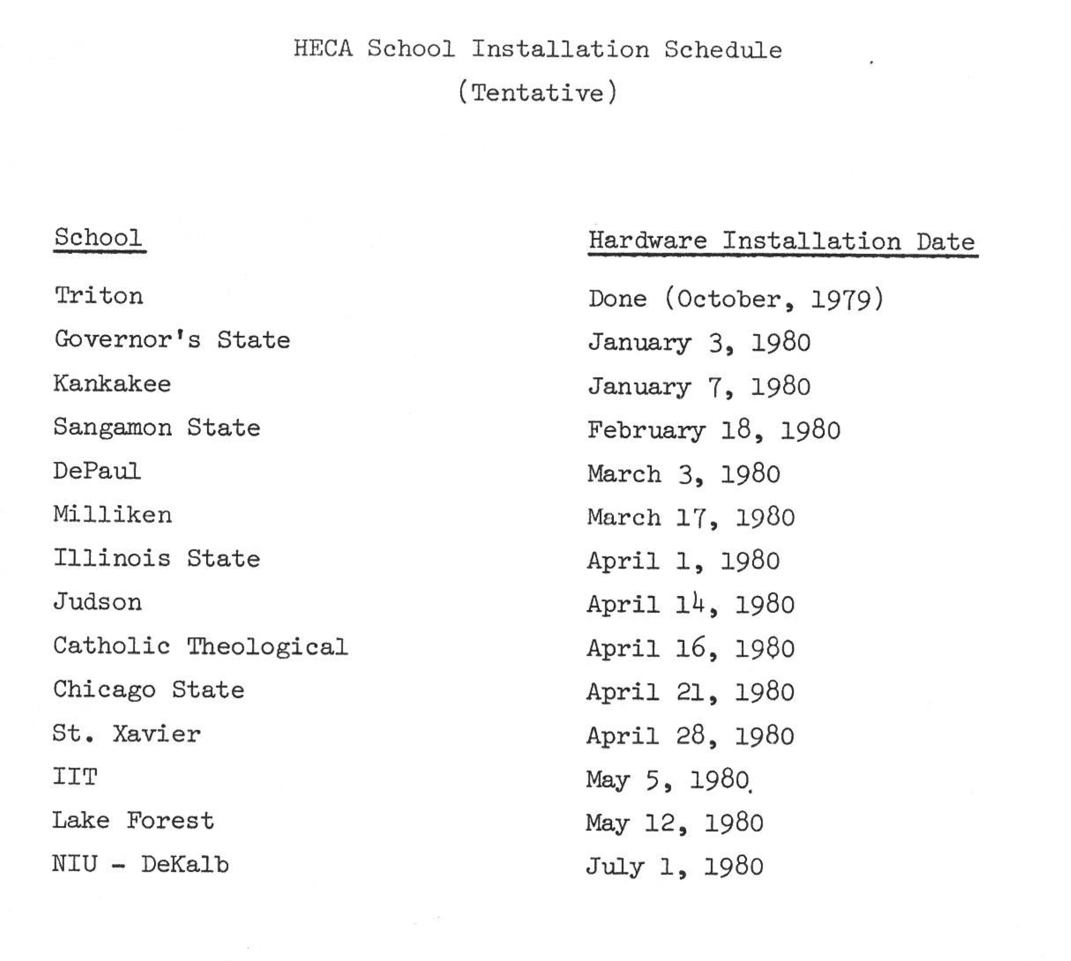
Notes:
This is an excerpt from the first LCS status report in 1979. These are the deadlines for installing hardware and networking at these institutions.

Slide 22
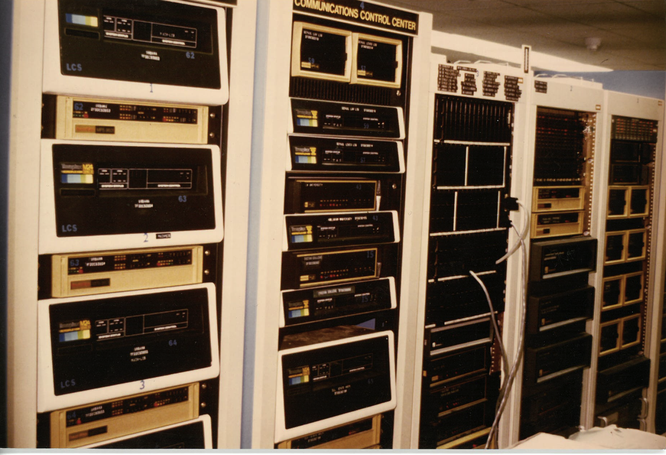
1980: There was no Internet as we know it. No Wifi.
All connections to LCS were by dedicated phone lines between the libraries and Roosevelt Road Building at UIC.
These are multiplexors that split phone lines over several ports (hard wired terminals or dial up ports)
Notes:
Installation included working with the library and Policy Council to determine the number of ports/terminals the library would have. Ordering the right size mux.Geting IL Bell to order the line, working with the library and their computer center (if they had one) to run cables from their mux to each terminal, and doing all of this to meet the project schedule without having email, cell phones or websites to keep in touch.

Slide 23
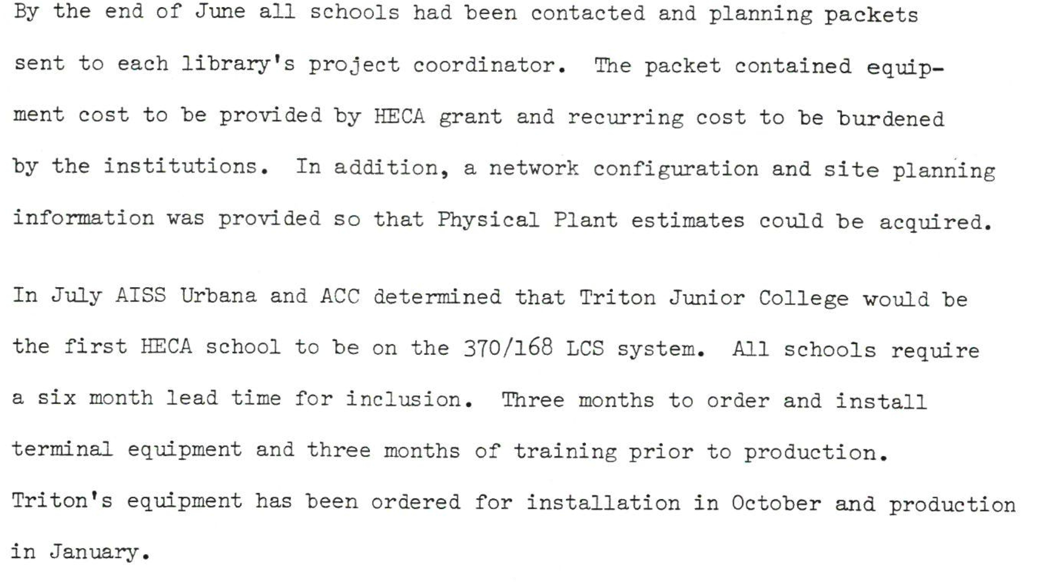
From LCS Status Report #1, August 1979

Slide 24
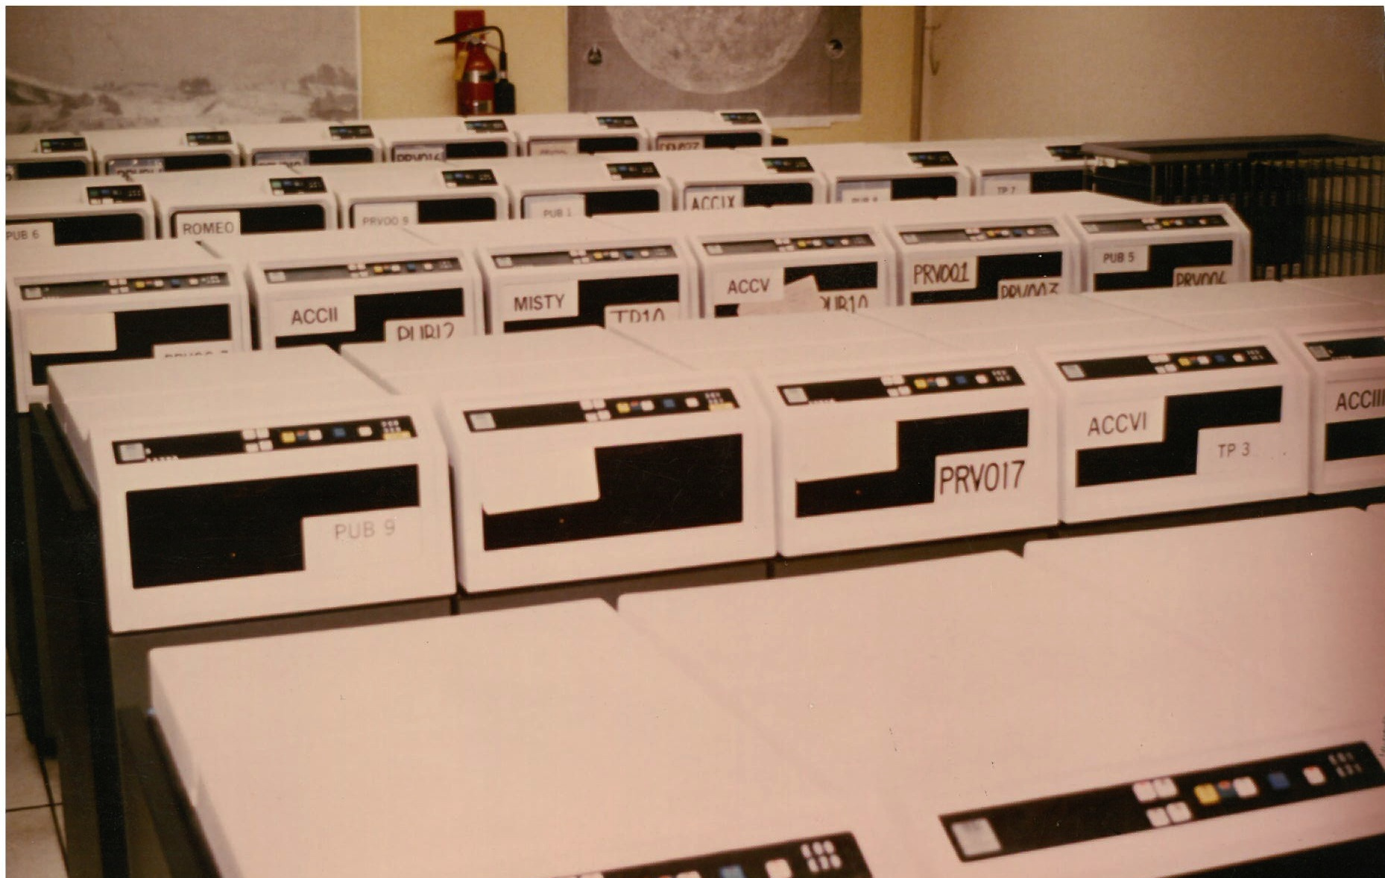
More infrastructure: Mass storage, was literally massive. These are washing machine sized disk drives that hold about 2.5 gb each.
Notes:
3380 held 2.5gb

Slide 25
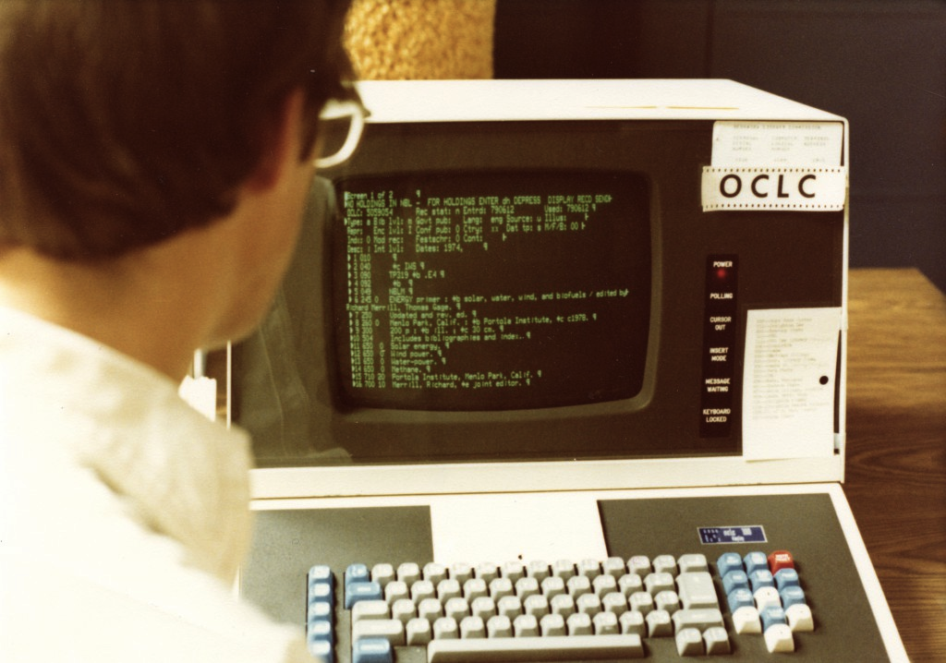
Retrospective Data Conversion
Not all was done via OCLC or full MARC
UIUC entered short records; used data entry contract firms, literally shipped out card catalog drawers for entry and edit.
By July 1983 LCS held
7.2 million titles
11.9 million items

Slide 26
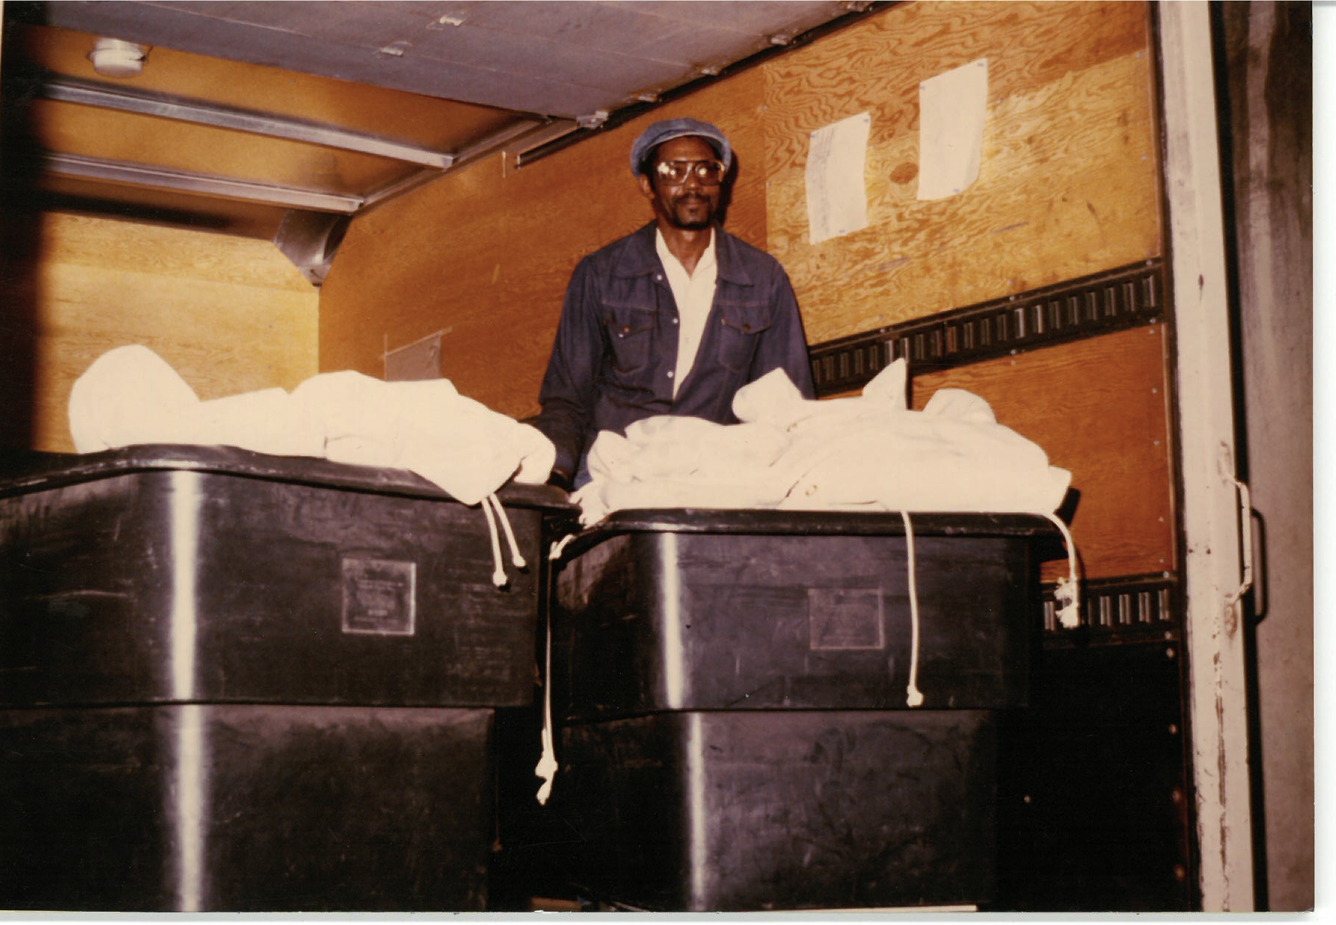
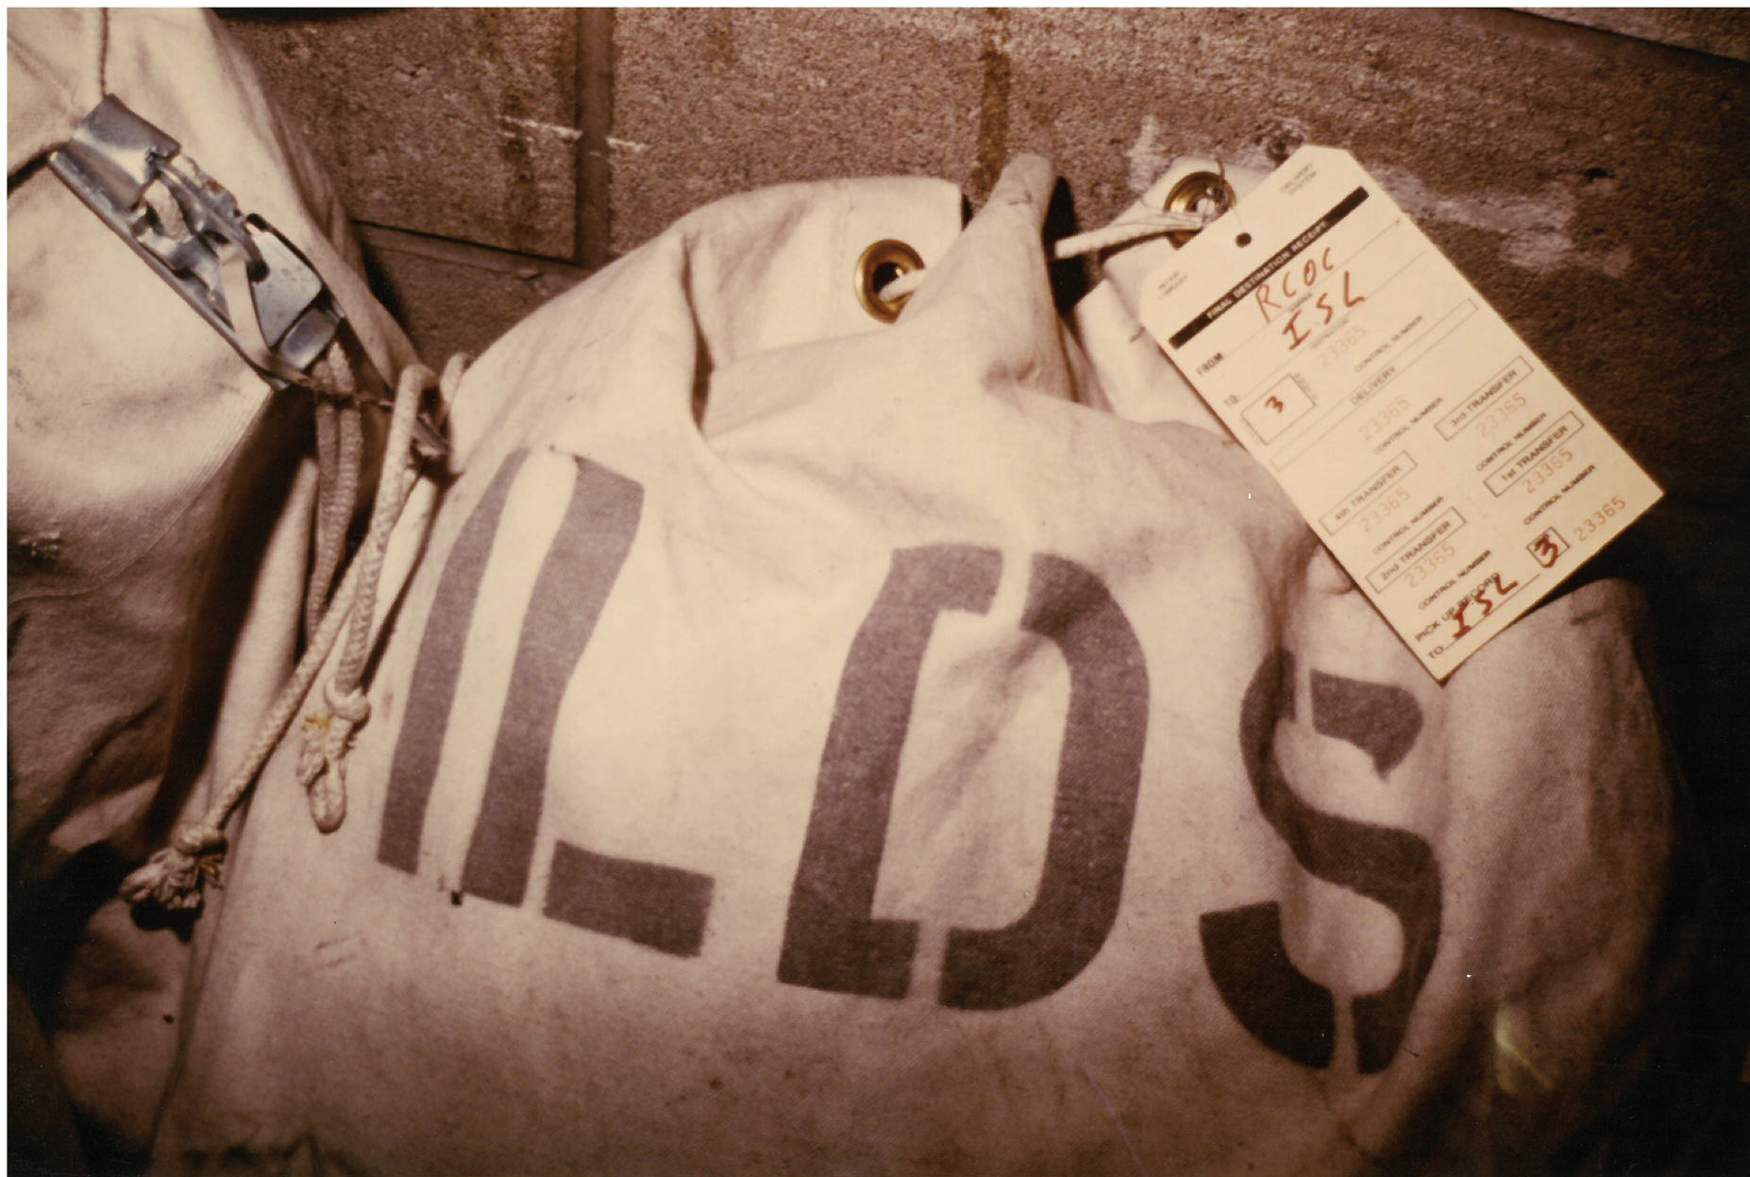
1980: Setting up ILDS
delivery

Slide 27
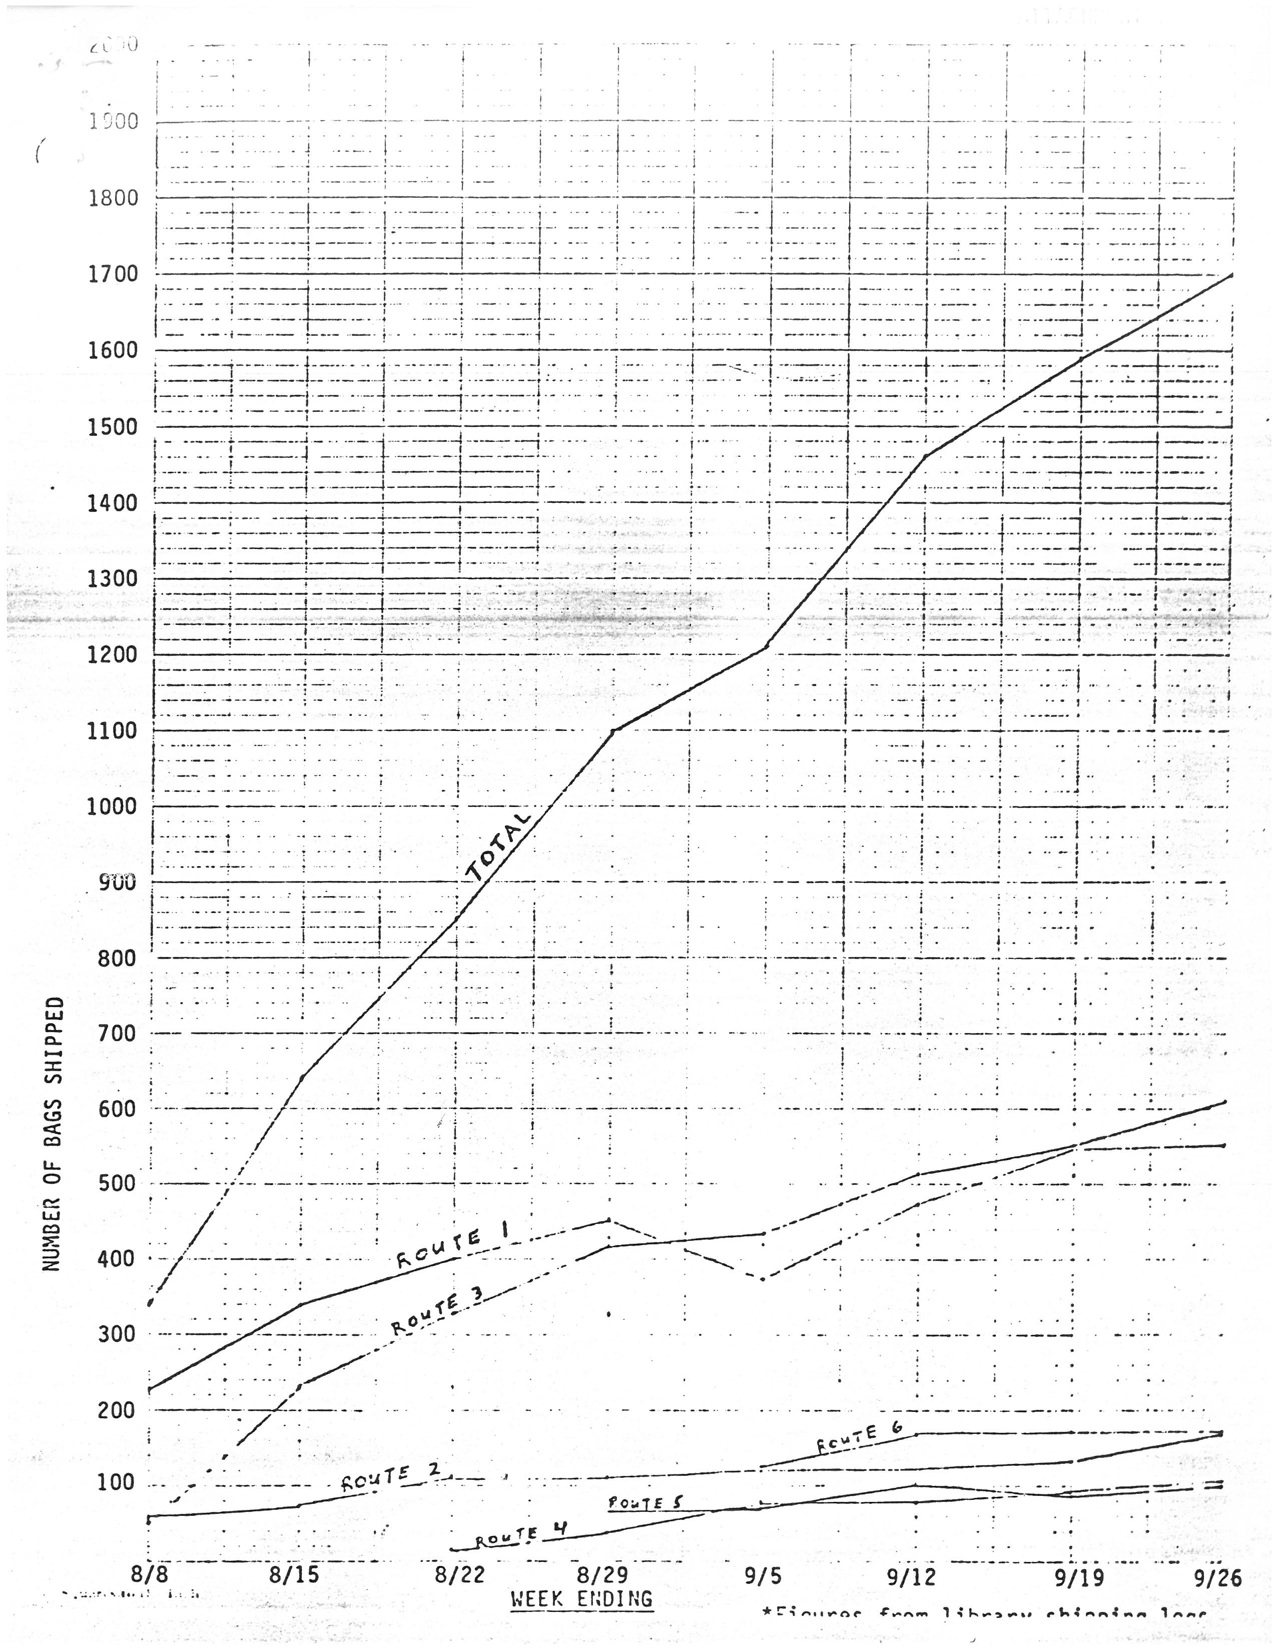
These are ILDS’ first usage stats, August-September 1980.
They didn’t have Excel then, this data was hand drawn at the time.
It carried 9572 bags and 48,385 items in the first two months of service.

Slide 28
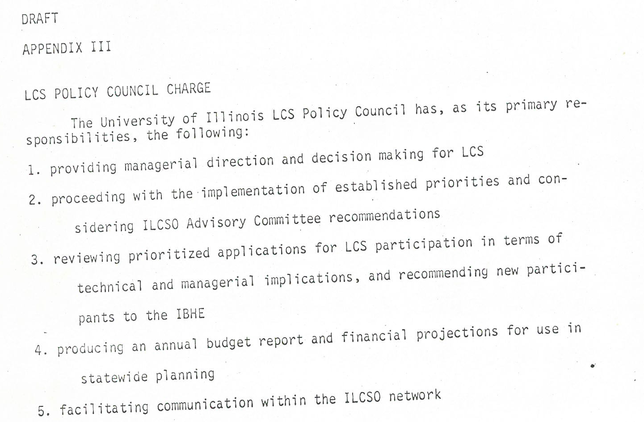
Setting up ILCSO Governance: First Draft of the LCS Policy Council Charge, February 1980

Slide 29
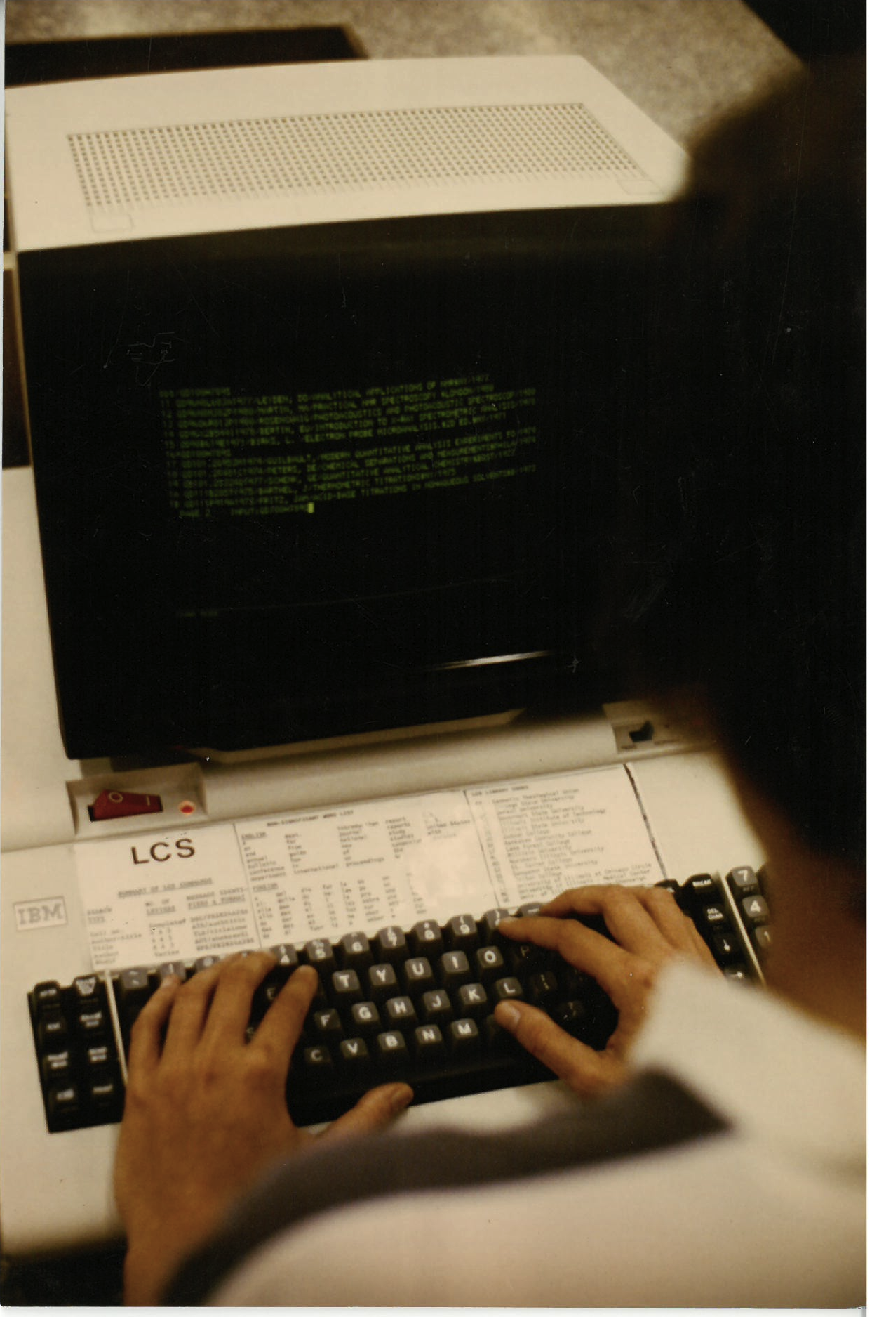

Slide 30
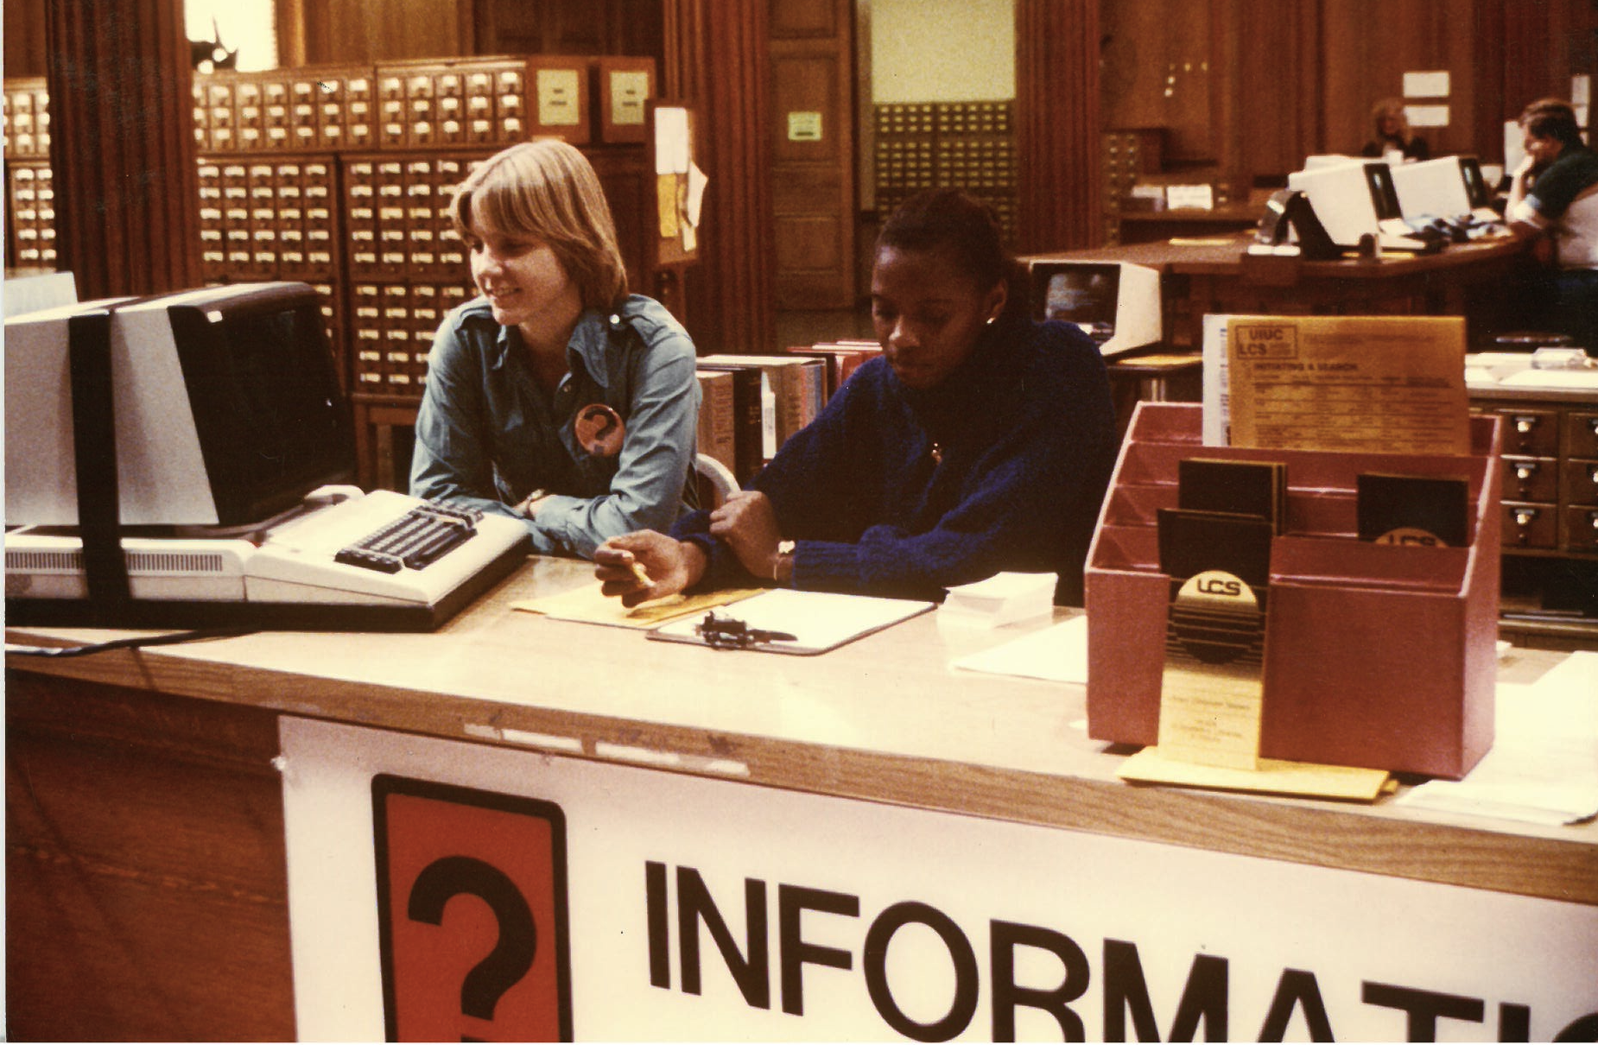

Slide 31
A Vision for Online Academic Library Cooperation in Illinois, Past and Present
A Library’s Perspective
Carlos Melian, Dean of Libraries, Northeastern Illinois University
CARLI Annual Meeting, November 13, 2015

Slide 32
Today
My History, Our History
Our “Stuff”
  Technology/Network
  Resource Sharing
  Organization/Cooperation/Collaboration
  Professional Development/Education
Now

Slide 33
My History
1980 – Working on MFA at UW-Madison
1982 – NEIU joins ILCSO, starts using LCS
1986 – Library Clerk in Acquisitions at NEIU
1987 – LCS and INNOVAC and SuperWylbur
1988 – Brad Baker becomes University Librarian at NEIU
1999 – Join Library faculty as tenure-track Technical Services Librarian at NEIU
2001 – Join Library Administration as AUL for Systems, Technical and Access Services at NEIU
2002 – Voyager
2005 – CARLI is formed, I-Share is established
2012 – Dean of Libraries at NEIU
Notes:
CARLOS please add a 1980 point for yourself, thanks Kris

Slide 34
Our History - Illinois Library Cooperation 50 to 38 Years Ago
1965 – Illinois Library System Act enacted
1966 – IBHE Master Plan calls for “…sharing library services…by all collegiate institutions, public and nonpublic…including using new electronic equipment...to establish a network throughout the state for rapid retrieval and transmission of material from one library to another. ”
1970 – Eighteen IL regional library systems in place
1971 – First Illinois Interlibrary Loan Code published.
1977 – State Library begins to provide OCLC services to Illinois libraries
1977 – UIUC funded to add multi-library features to LCS (Library Computer System) software from Ohio State University

Slide 35
Our History - Illinois Library Cooperation 37 to 35 Years Ago
1978 – IBHE and IACRL recommend $500,000 HECA (Higher Education and Cooperation Act) funding to expand LCS to 14 additional institutions: 7 private colleges, 5 state universities, and 2 community colleges
1978 – UIUC live on (LCS)Library Computer System in December
1979 – LCS terminals installed at 18 Illinois regional library system headquarters. Library systems begin borrowing materials from UIUC library via LCS
1980 – ILCSO, the Illinois Library Computer Systems Organization is formed to advise the UI admin on the policies relating to the operation of LCS
1980 – ILDS, statewide delivery service begins in September
1980 – 15 institutions circulating and sharing on LCS by end of year

Slide 36
Our History - Illinois Library Cooperation 31 to 16 Years Ago
1984 – UIUC and River Bend Library System jointly implement the Full Bibliographic Record (FBR) online catalog
1988 – All Illinois OCLC cataloging added to FBR, system re-named “ILLINET Online”; MARC data adds keyword and subject access for 800+ libraries; and links to LCS for circulation and requesting
1990 – ILCSO implements statewide dial-access borrowing for all ILLINET libraries.
1991 – Illinois State Library moves its catalog to ILLINET Online; barcode support added to LCS
1994 – State Library begins providing OCLC FirstSearch databases to all libraries and their users.
1999 – Illinois Century Network formed.
1999 – VIC (Virtual Illinois Catalog) and Find-It! Illinois announced to library community.

Slide 37
Our History - Illinois Library Cooperation 15 Ago to Present
2002 – ILLINET/OCLC Services institutes group services flat rate pricing for Illinois libraries.
2002 – Voyager replaces LCS/FBR as the ILLINET Online software
2005 – CARLI is formed, ILLINET Online renamed I-Share
2008 – ILDS, the statewide delivery backbone, is reorganized. CARLI contracts for service beginning in January
2015 – CARLI begins search for software to replace Voyager

Slide 38
Our “Stuff”
Technology/Network
Resource Sharing
Organization/Cooperation/Collaboration
Professional Development/Education

Slide 39
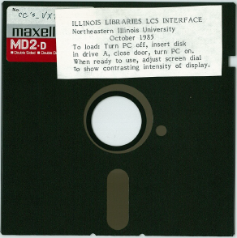
Technology/Network

Slide 40
Technology/Network
Networked services (Circulation, Catalog(ing), etc.)
Systems (Voyager, SFX, etc.)
Online environments (Sharing content and services between libraries and for our users)
Technology vendors
Shift to access
Ahead of the curve/behind the curve

Slide 41
Resource Sharing
1981 – 88,305 “Interlibrary Circulation Transactions” (Sloan)
2002 – Voyager
2003 – 211,195, 56 libraries (Voyager)
2005 – 344,147, 65 libraries (I-Share)
2012 – 441,841, 78 libraries (High)
2015 – 378,041, 84 libraries (Current)
Sources: Sloan, Bernard G., “The LCS Network Project, December 2, 1980 and CARLI Website, http://www.carli.illinois.edu, November 10, 2015

Slide 42
441,841
378,041
211,195
Source: CARLI Website, http://www.carli.illinois.edu/products-services/i-share/stats, November 10, 2015

Slide 43
Source: CARLI Website, http://www.carli.illinois.edu/membership/i-share_part, November 10, 2015

Slide 45
Resource Sharing
Unique collections
  33,371,279 titles in 2015
  9,026,118 unique titles (27%)
  NEIU – 27,792 unique titles
Unique institutions and specific needs
  118,674 items (31%) borrowed by 4 institutions (UIU, UIC, DPU, SIC) in 2015
Beyond the shared collection
  Reaffirmation of our services at our institutions
  NEIU Library fire in 2005

Slide 46
Organization/Cooperation/Collaboration
136 CARLI members, 84 I-Share members
Shared policies and practices
Shared library collections and shared spaces
Shared initiatives
Sense of “public good”
Incredible network of experts, technical and professional support
Value (bang for your buck)
“Loss of control”

Slide 47
Professional Development/Education
Opportunity for all library staff to participate and learn
Real experience for collaborative/group work and discussion
Knowledge of libraries, the consortium and the state
Established network of colleagues
Opportunity for professional activities
Opportunity to be informed about “how other libraries do it”

Slide 48
State Agency Perspective-
CARLI Early History and Development
J. David Stewart
University of Illinois Asst. Vice President for Planning and Budgeting
Retired

Slide 49
My history
1980-83 IBHE- Asst., later Associate, Director of Fiscal Affairs
1983-86 VP for Administration and Treasurer, Lake Land College
1986-2005 UI Assistant Vice President for Planning and Budgeting- assigned to ILCSO administration and financial planning
1987-88 Established ILCSO Office to support ILCSO Consortium and its statewide library services
1987-98 Pursued grants and permanent funding to support Enhancement and Expansion of ILLINET Online
1998-00 Developed grant funding and permanent financial support for Illinois Digital Academic Library (IDAL)
2004-05 Worked with committee on plans for consolidation of ILCSO, IDAL, and CCMP into CARLI
2005-2008 Interim Associate Vice President for
University Human Resources, University of Illinois
July 2008 Retired from UI

Slide 50
Illinois’ long tradition of academic library resource sharing
1966 IBHE Master Plan for Higher Education:
“…these circumstances challenge the library community to find way of pooling resources and increasing utilization of their collections and services.”
“By means of new electronic equipment, it may be possible to establish a network throughout the state for rapid retrieval and transmission of material from one library to another.” (p.36)

Slide 51
IACRL, IBHE, ISL Committee
IBHE study in 1969 recommended exploration of a statewide automated library network
IBHE, ISL and IACRL worked with a task force of public and private institutions
Acknowledged that state funding would be necessary to support resource sharing

Slide 52
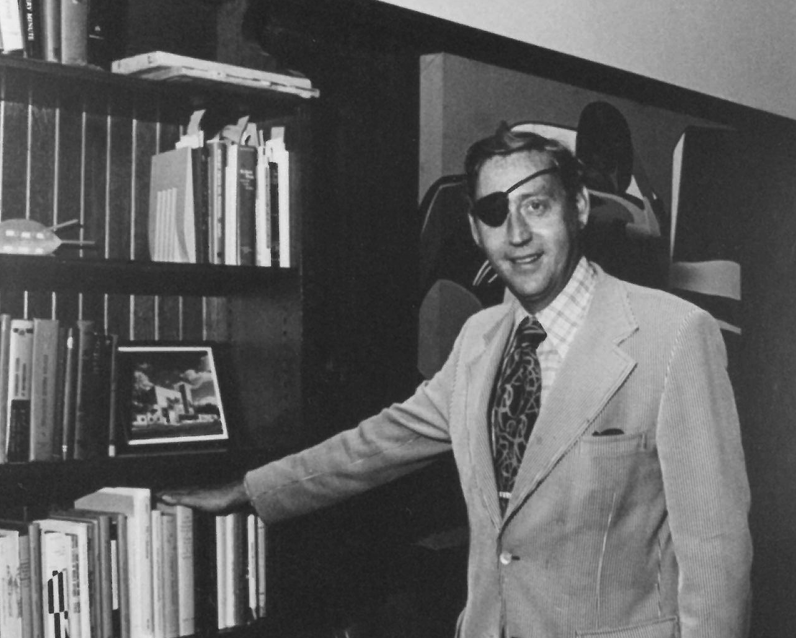
The late Hugh Atkinson, then University Librarian at UIUC, had a clear vision for cooperation and resource sharing.
He advocated IBHE HECA grant funding for all types of academic libraries
“I don’t mind lending 100 books if I can borrow 10 books U of I patrons need. Strict reciprocity is less important to me than satisfying patrons.”
-- Hugh Atkinson, American Libraries, 1980

Slide 53
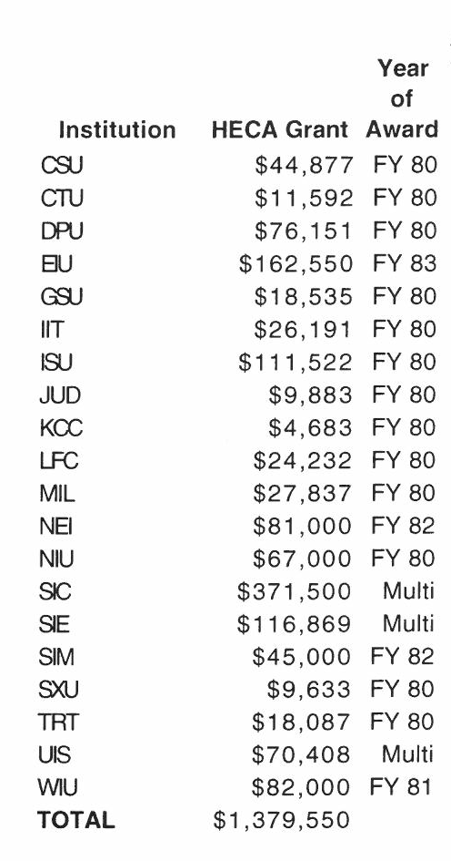
IBHE provided start-up funding of Higher Education Cooperation Act (HECA) grants to participating institutions to support retrospective data conversion and local computer hardware costs.

Slide 54

Factors contributing to successful consortium development

Slide 55
Common needs and goals led to development of the ILCSO consortium with a self-governing body
ILCSO Policy Council representing various institutional types and funding agencies
Sharing of library resources is cost effective, provides more/better patron access to combined wealth of library resources
Individual institutions find it difficult to maintain currency and comprehensiveness of library collections due to budgetary constraints, rising library materials costs, explosion in volume and sources of information resources
Large and small libraries have unique items in their collections
Economies of scale in computing and data storage

Slide 56
True partnerships in funding and support for consortium and resource sharing
IBHE wanted to develop highly visible and successful model of diverse inter-institutional library cooperation and resource sharing
ISL played a vital role in supporting the development of the statewide resource sharing including providing grant funds, implementing a statewide library materials delivery system (ILDS) in 1980, and using ILLINET Online as its own system beginning in 1991.
Beginning in FY 1988, ILCSO member libraries contributed financially to support the growth and development of the consortium and resource sharing system through a series of annual membership assessments.

Slide 57
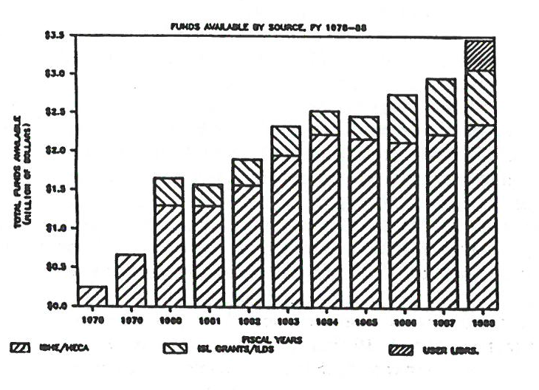
Funding FY1978-FY1988
Providing a stable and sufficient funding base from several diverse funding sources was considered essential to the future success of the consortium.
Goal was a financially self-sustaining consortium.
Annual funding increased from $250k in FY78 to $3.5m in FY88
Notes:
Library High Tech article graphic

Slide 58
Funding FY1987-FY2001
From FY87 through FY2001, ISL and IBHE provided grant support and IBHE recurring base funding of $14.7 million
  Non-recurring grand awards $12.4m
    From IBHE $5.25m
    From ISL $6.9m
    From USDOE $200k
  Permanent recurring funds $2.3m
    State IBHE Budget adjustments
    earmarked for ILLINET Online and
    Illinois Digital Academic Library

Slide 59
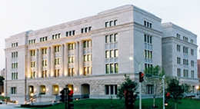
Illinois State Library/
Academic Libraries
Partnership
No little plans
Prepared for the CARLI Annual Meeting
November 13, 2015
Anne Craig, Director
Pat Boze, Consultant
Illinois State Library
acraig@ilsos.net

Slide 60
Our History
Anne
1985-1989: NIU Founders Memorial Library; periodicals, reference, ILL and reserves
1988: MA in Library Science from NIU
1989-present: ISL!
1989-1990: Reference Librarian
1990-1993: OCLC Network Coordinator
1993-1998: Coordinator Public Services
1998-2005: OCLC Services Network Director; Associate Director Automation and Technology
2005-present: Director
Pat
1977-1982: Had 3 children
1983–1988: Worked part-time at Robert Allerton Park
1989: MLS from UIUC
1990: Library Research Center, UIUC
1992: CE Consultant, Lincoln Trail Libraries System
1999: Automation Consultant in charge of LINC, LTLS LLSAP
2004: Migrated 90 LINC libraries from Dynix Classic to Horizon
2007: Managed ISL WorldCat Local project, LTLS
2012–present: Library Development Group, Illinois State Library

Slide 61

Driving State Library services
Statute enabled
  Library service to government and residents
  Library service to the print-impaired
  Library service to citizens with low literacy skills
  Preservation of government publications (tangible & electronic)
Grants management
  State
  Federal (block grants & competitive)

Slide 62

Resource sharing
What?
  Sharing materials, expertise
    Borrowing and lending books, DVDs
How?
  Libraries list their materials on the Internet
  Materials move around the state on delivery trucks
Why?
  Great leverage:
    Collections to provide needed resources to all
    A consortium’s size can help negotiations
  The work of one can be repurposed (e.g., shared cataloging, technology, expertise)
  Levels the playing field

Slide 63
How does the ISL support resource sharing?
Administration of the rules for laws
Grants to:
  Library consortia (CARLI)
  ILLINET libraries: Per Capita, construction
  Library systems (CPLS, IHLS, RAILS)
    Area & Per Capita grants support: delivery, catalogs
    Special grants support:
      Talking books
      OCLC statewide billing
      WebJunction
      Cataloging Maintenance Centers
      The MARC of Quality file processing for catalogs

Slide 64
Who receives Secretary of State/
Illinois State Library grants?
Library systems
School libraries
Library consortia
Literacy providers
Academic libraries
Special libraries
Public libraries
ILLINET members and literacy providers

Slide 65
What is “ILLINET”?
Illinois Library and Information Network
An ILLINET member library
=
Any library in Illinois that is a member of a library system

Slide 66

Illinois Library Information Network
  Each library/library organization must belong to one of the library systems to qualify for SOS/ISL services and grants
  Certification annually verifies that libraries meet system membership criteria
  Each ILLINET member has made a commitment to resource sharing
Notes:
Could the caption read something like: “Who is impacted by these grant reductions and delayed payments?” ILLINET (Ill……..) Add 3rd dash that would say “Each is committed to resource sharing”

Slide 67

Illinois’ Library Systems: then and now
Began in 1965; established by statute; receive direct appropriation
Annual formula based grant from State Library with state dollars
Funding has fluctuated:
  Now, $15 million
  Zenith of $20 million FY03
18 then; 3 now
Then, critical services:
  Collections, ILL, reference, library development
Now, critical services:
  Delivery, consortial catalogs of 800+ Illinois libraries
Then and now, critical services:
  Training, consulting

Slide 68
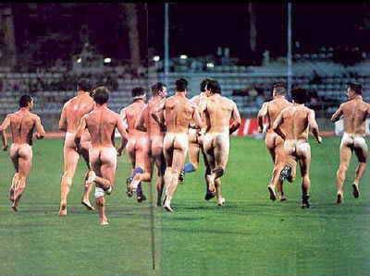
1974
Streaking is a fad.
The Moped is a popular mode of transportation.
President Nixon resigns after impeachment begins.

Slide 69
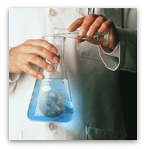
Meanwhile in Illinois…
1974
Online Computer Library Center (OCLC)
The “OCLC Experiment” to use OCLC for cooperative cataloging begins with a federal grant award of Library Services and Construction Act (LSCA) funds. The first Illinois OCLC members include:
  Illinois State Library
  Chicago Public Library
  University of Illinois
An additional Illinois Board of Education grant is awarded to the Illinois State Library to expand the OCLC program to additional academic libraries.

Slide 70

1977
The first Star Wars Movie is released.
The cost of a gallon of gasoline is $.62

Slide 71
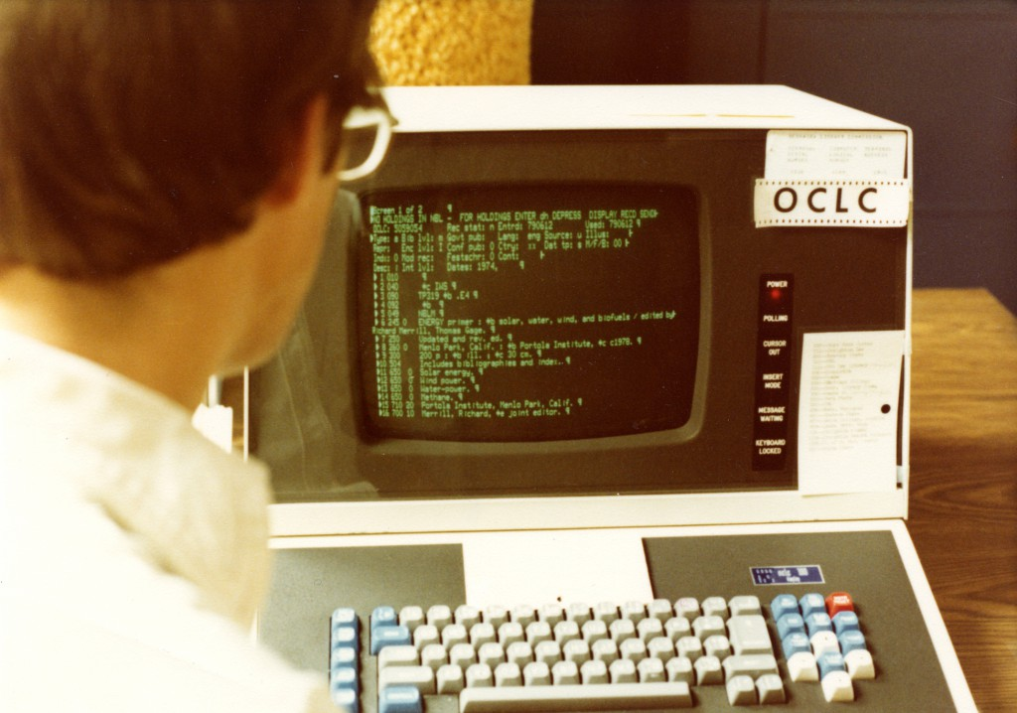
Meanwhile in Illinois…
1977
A two-year grant project grant of $150,000 is awarded to the Illinois State Library to assist in incorporating the OCLC Program within the State Library organization.

Slide 72
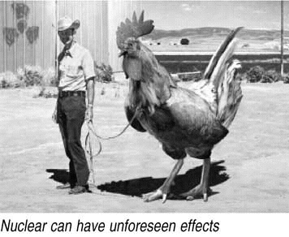
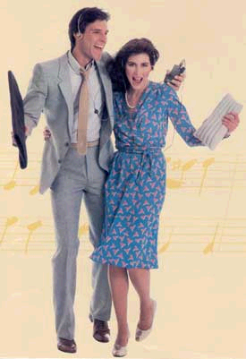
1979
The Three Mile Island nuclear plant
accident propels the “No Nukes”
movement.
The median household income
is $16,461.
The Sony Walkman tape player
starts a fad.

Slide 73

Meanwhile in Illinois…
1979
Roughly three million holdings are added to OCLC from Illinois libraries.
Six libraries are approved as test libraries to use the newly developed OCLC Interlibrary Loan Subsystem, in a multitype setting, utilizing OCLC for both shared cataloging and interlibrary loan.

Slide 74
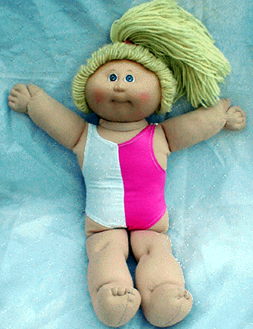
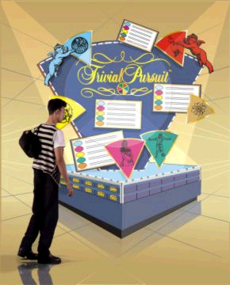
1983
Sally Ride becomes the first American woman in space.
Microsoft Windows debuts.
The Trivial Pursuit craze begins.
Cabbage Patch Kids are the best
selling toy of the year.

Slide 75

Meanwhile in Illinois…
1983
OCLC membership in Illinois reaches 280 multitype members from academic, public, school, and public libraries.
The Multitype Library System Act was adopted and library systems became multitype (more than just public libraries—academic, school, and special libraries too).

Slide 76
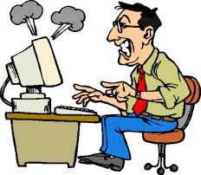
1989
The Berlin Wall opens.
The Exxon Valdez spills eleven million gallons of oil in Alaska.
Researchers try to index the exploding Internet; they can’t keep up.

Slide 77

Meanwhile in Illinois…
1989
SILO membership includes over 500 libraries, making it one of the largest of over 100 OCLC union list groups.
Illinois is a Resource Sharing State!

Slide 78
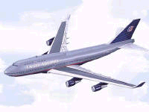

1990
Smoking on domestic airplane flights is banned.
IBM sells its Selectric division, a death knell for the typewriter.

Slide 79

Meanwhile in Illinois…
1990
SILO membership exceeds 700 libraries, contributing over 400,000 serials holdings.
SILO becomes the third largest union list group in OCLC, surpassed only by the New York Consolidated and the U.S. Newspaper Program union lists.
The Illinois State Library Gwendolyn Brooks Building is opened at a cost of $36 million dollars.

Slide 80
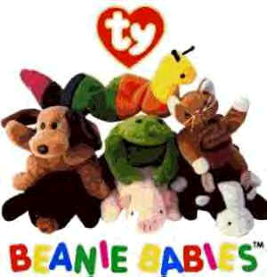
1993
The Beanie Baby makes its debut.
HTML is introduced as the code for Web design.

Slide 81
Meanwhile in Illinois…
1993
I SAW LVIS AT THE LIBRARY
The LVIS (Libraries Very Interested in Sharing) group is formed, as a way to identify and route requests to libraries within OCLC that agree not to charge a fee photocopies.
LVIS begins as a venture between MLNC and ILLINET, which started with 181 multitype libraries in Illinois and Missouri.

Slide 82



1994
The existence of black holes is proved.
The Chunnel opens, bridging England and France.
Yahoo search engine is started by two Stanford graduate engineering students.

Slide 83
Meanwhile in Illinois…
1994
The Illinois State Library begins a statewide pilot program, funded by a $75,000 grant, to provide a selection of 33 FirstSearch databases to 195 multitype Chicago Library System member libraries at no charge.

Slide 84


1996
FBI arrests suspected Unabomber, Theodore Kaczynski.
The “virtual pet” is the latest fad for kids.
The Tickle-Me-Elmo doll becomes the most popular Christmas present.

Slide 85

Meanwhile in Illinois…
1996
The Virtual Illinois Catalog (VIC) is born out of a collaborative decision between Regional Library Systems and the Illinois State Library, to provide access to the holdings of the then twelve Regional Library System automated catalogs.

Slide 86

2001
The September 11 terrorist attacks shock the nation.
Carroll O’Connor dies.
Global warming...

Slide 87
Meanwhile in Illinois…
2001
The Illinois State Library launches Try-It! Illinois database trials.
Every Library in ILLINET (ELI), the Illinois State Library’s online directory of libraries, is launched.
The Bill and Melinda Gates Foundation awards approximately $4 million to Illinois public libraries for public access computing.
The total number of FirstSearch users in Illinois includes 1,404 schools, 956 public and 58 academic libraries.

Slide 88

2003
For the first time, more DVDs than videotapes are rented in the U.S.
Supreme Court mandates porn filters in federally funded public libraries.
Cell phones add computer and Internet capabilities.

Slide 89

Meanwhile in Illinois…
2003
The Illinois State Library celebrates 10 years of offering OCLC FirstSearch to Illinois libraries at no charge FirstSearch is provided to over 2,214 libraries.
The Illinois State Library joined an OCLC Pilot Project to test the use and functionality of the OCLC Group Catalog as a possible new platform for VIC.
The Illinois State Library partnered with OCLC to provide a pilot to 50 Illinois libraries for OCLC’s virtual reference service, Question Point.

Slide 90

2004
One of the worst natural disasters in recorded history hits Southeast Asia when the strongest earthquake/tsunami in 40 years hits the entire Indian Ocean region.
Ronald Reagan dies at 93.
A 1.3 kg chondrite type meteorite strikes a house in Ellerslie, New Zealand, causing serious damage but no injuries.

Slide 91

2004
Meanwhile in Illinois…
The Statewide Illinois Library Catalog (SILC) was born!

Slide 92
Now

Slide 94
(Re-)Evaluation
  Is the downward trend in transactions a reliable/meaningful measure today? Need for analysis and possible solutions.
Collection is shrinking
  Continuing shift to electronic collections
  Shrinking budgets
  Sharing electronic collections
  Resource “sharing” is changing
  Agreements between us may be more difficult due to budgets, publishers and other factors
Open Access
Institutional Repositories
I-Share Next
Shift to other priorities
Changing demographics of our students

Slide 95
(Re-)Evaluation
Changing staffs
Young, energetic and very intelligent librarians
Need to overcome many obstacles (time and money)
Re-form groups and committees (ad hoc task forces?)
Where does CARLI fit in today’s networked/cloud environment?
Balance responsibilities at our individual libraries with responsibilities for all of our libraries (personal and institutional)
How do we get “ahead of the curve” more often?
There is a real need and opportunity at this point to re-evaluate our work as a consortium

Slide 96
Today

Slide 97


Slide 98

2015 ILLINET Statistics
Illinois libraries…One big family
  Academics: 169/183 with branches
  Publics: 639/799 with branches
  Specials: 250/256 with branches
  Schools: public 700/private 95 (district offices)

Slide 99


New Administrative Rules
Compliance with new ILL Code is mandatory.
Certification is mandatory.
Completion of ILL Traffic Survey is mandatory.
New definition of “Academic Library:”
“…means the library or libraries of an institution of education beyond the secondary level that is recognized by the Illinois Board of Higher Education as either an Illinois academic institution or an out-of-state academic institution with a physical presence in Illinois.”

Slide 100



Many cooperative projects
Delivery service
Digital Public Library of America Service Hub
Library Systems
  Automation programs and delivery
  Administrative responsibilities like membership and certification
  OCLC billing
  Cataloging Maintenance Center
Programs like E-Read Illinois and the Dream Grant
Statewide OCLC services
  FirstSearch/WorldCat Discovery Services
  Group services agreement
WebJunction and Skillsoft
Illinois Veterans’ History Project
Illinois Digital Archives
  Digitization grants
Government Documents

Slide 101

Today: OCLC and the ISL
Two agreements
  Group services-paid for by libraries
    Unlimited use of ILL and cataloging
    9.6 million ILL transactions in FY2005
    45.7 million in FY2014
  FirstSearch (WorldShare)-$1.4 million paid by ISL
    Web visibility to Illinois’ vast OCLC holdings
    Access to e-content
Academic libraries play a key role in the strength of the network

Slide 102
Today: OCLC FirstSearch
ILLINET member libraries have full access to the OCLC FirstSearch Base package subscription:
  WorldCat, Electronic books, ArchiveGrid, ArticleFirst, CAMIO Catalog of Art Museum Images Online, Electronic Collections Online (Abstract & Index), OAIster, PapersFirst, ProceedingsFirst, WorldCat Dissertations and Theses, ERIC, GPO Monthly Catalog and MEDLINE
WorldCat Discovery will be the new interface and platform for searching the FirstSearch base package
  Late 2016 phase-in

Slide 103
Today: Try-It! Illinois until 11/30
ABC-CLIO
Adam Matthew Digital
BioOne
Britannica Digital Learning
Capstone, Inc.
Career Cruising
FactCite: Lincoln Library Online
Faulkner Information Services
Gale-Cengage Learning
Gleeditions LLC
InfoBase Learning
Information Today Inc. - Faulkner Information Services
Morningstar, Inc.
Naxos of America, Inc.
Oxford University Press
Plunkett Research
ProQuest
Record Information Services, Inc.
S&P Capital IQ
Sage Publications, Inc.
Salem Press
SCOLA
TeachingBooks.net
The World and I Online
ThinkMap
Total Boox

Slide 104


Grant Programs
ISL uses federal Library Services and Technology Act funding to foster partnerships among libraries
ISL uses state grant funds to foster library development in Illinois
  Digital imaging
  Literacy
  Library Systems
  Technology
  Construction
  Talking Book and Braille Service
  School and public library per capita grants
  Veterans’ homes

Slide 105
FY15 Literacy Grants to CARLI organizations
Black Hawk College | 59,000
Carl Sandburg College | 56,000
College of DuPage | 42,260
Danville Area Community College | 53,260
Frontier Community College | 55,000
Highland Community College | 47,000
Illinois Valley Community College | 52,000
John A. Logan College | 63,000
John Wood Community College | 53,260
Joliet Junior College | 46,760
Kankakee Community College | 56,260
Kaskaskia College | 70,260
Kishwaukee College | 45,000
Lake Land College | 53,000
Lewis and Clark Community College | 59,000
Lincoln Land Community College | 62,000
McHenry County College | 47,566
Moraine Valley Community College | 38,500
Morton College | 30,000
Oakton Community College | 74,260
Parkland College | 63,000
Prairie State College | 56,260
Rend Lake College | 46,260
Richland Community College | 67,000
Sauk Valley Community College | 34,494
Shawnee Community College | 26,260
South Suburban College | 23,801
Southwestern Illinois College | 65,000
Spoon River College | 41,965
Triton College | 36,500
University of Illinois | 25,000
Waubonsee Community College | 75,000
Black Hawk College | 35,000
Black Hawk College | 35,000
Black Hawk College | 35,000
College of DuPage | 35,000
College of DuPage | 35,000
College of DuPage | 25,000
John A. Logan College | 35,000
John A. Logan College | 35,000
John A. Logan College | 35,000
Kaskaskia College | 32,000
Lewis and Clark Community College | 35,000
Lincoln Land Community College | 33,017
Southwestern Illinois College | 35,000
Southwestern Illinois College | 35,000
Oakton Community College | 10,000
Richland Community College | 14,000
South Suburban College | 11,500
South Suburban College | 15,000
South Suburban College | 13,212
South Suburban College | 14,000
University of IL at Urbana-Champaign | 14,500
University of IL at Urbana-Champaign | 13,000
University of IL at Urbana-Champaign | 13,500
University of IL at Urbana-Champaign | 14,000
William Rainey Harper College | 14,250

Slide 106

Professional Development
ILEAD U and ILEAD USA
  Team LIBRAS 2014
  Team Make It Count 2015
Synergy
On the Front Lines
Team Make It Count

Slide 107


Online CE available to all!
Skillsoft
  450 online self-paced courses and over 4,000 short instructional videos
WebJunction

Slide 108

Lots of CARLI reps on ISL committees…
ISLAC
Delivery
ILL Code
Illinois Government Depository Council
To name just a few…

Slide 109

Delivery Committee
Brought system delivery and ILDS together to work on standards and vision

Slide 110

Provide services that are only feasible with many participants
  e.g. catalogs, delivery, purchasing
Statewide, collaborative services should be king; no duplication if possible
Identify and address emerging needs of all members
  Help the struggling
  Support the philosophy of the statute

Slide 111

Why has the partnership worked?
Similar philosophical roots of cooperation:
  Multitype library network strengthens all
  In working together, all pieces benefit
Teamwork
Lean into each other’s strengths

Slide 112
Need for Ongoing Library Advocacy

Slide 113
Creating CARLI 2005
CARLI founded in July 2005 after consolidating 3 existing Illinois academic library consortia: ICCMP, IDAL and ILCSO
CARLI designed to improve efficiency and cost effectiveness of services, create new programs and opportunities

Slide 114
The Present Situation
CARLI has a strong record of success but cannot take for granted that past financial support will continue without advocacy efforts
State’s deteriorating fiscal condition and uncertainty about current and future resources evident
Advocacy not limited to asking for more funds—need to preserve existing budget base
External and internal advocacy are critically important; Need to garner continued support from institution’s own administrators and board members

Slide 115
Challenges
Turnover among key institutional administrators, board members, and funding agency staff call for renewing and continuing advocacy efforts
Even long-standing successful consortium programs and services may become “targets of opportunity” for budget reductions and reallocation especially in times of severe financial stress
Institutions looking to reduce administrative costs, reallocate resources due to severe budget pressures
Decision makers want to see evidence of demonstrable return on investment of scarce resources

Slide 116
Opportunities
CARLI can demonstrate cost-effective benefits of cooperation and resource sharing
Emphasize the benefits of group purchasing, shared costs of operating a statewide network, and high value of services provided through a consortium
Indicate the cost-saving benefits of participation in CARLI vs going alone
CARLI members have an opportunity to showcase success and patron services through annual reports, news releases, conference presentations, and other media
Collectively CARLI member institutions represent a significant advocacy group

Slide 117
I-Share Growth 1978-2016

Slide 118

How did they do all of this in 1980?
There was no email, no Internet, no websites for sharing information
OCLC had only been operating in Illinois for 6 years, most catalog records were not in “machine readable” format
People were no less skeptical and resistant to change than they are now
How did they pull this off?

Slide 119
How did they succeed ?
They took risks
They worked together
They told their story and advocated for support
They knew that they could achieve things together that none of them could achieve on their own
We can and do still do this

Slide 120

I’ll let Hugh have the last words:

