Slide 1
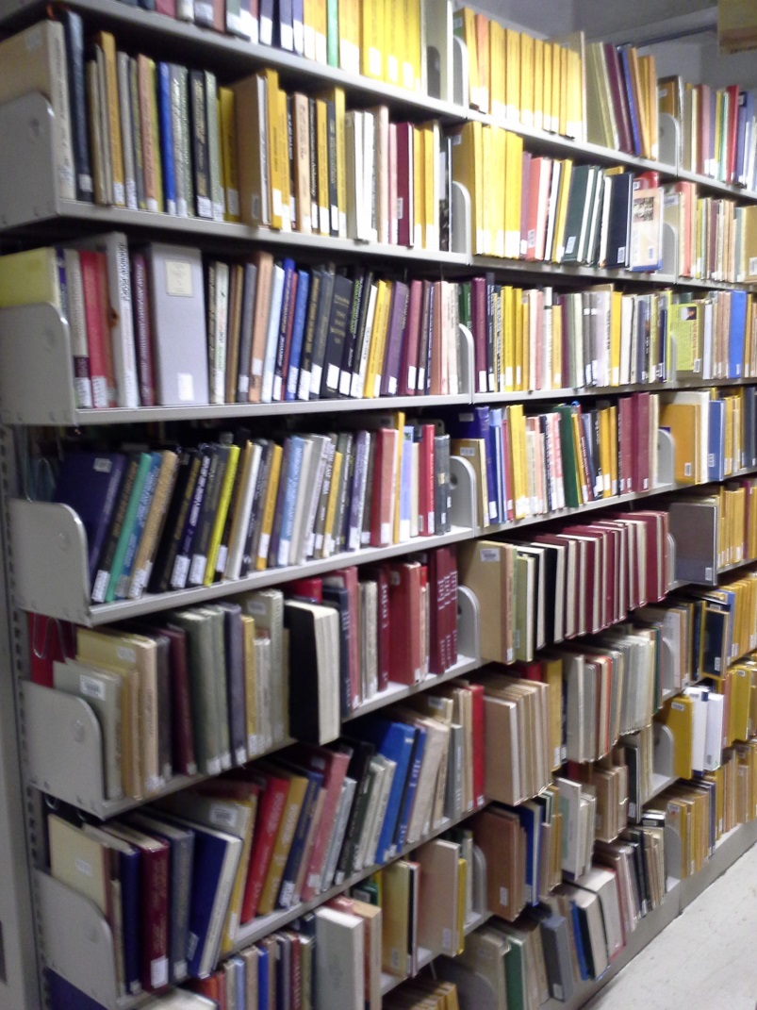
Weeding
2014
CARLI Collections Management Committee (CMC)

Slide 2
CARLI Collection Management Committee 2013/14
Kim Fournier, Chair, William Rainey Harper College
Jeffry Archer, University of Chicago
Chad Buckley, Illinois State University
Pam Hackbart-Dean, Southern Illinois University Carbondale
Jane Hopkins, Greenville College
John Small, North Central College
Todd Spires, Bradley University
Lynn Wiley, University of Illinois at Urbana-Champaing
Elizabeth Clarage, CARLI
Jen Masciadrelli, CARLI

Slide 3
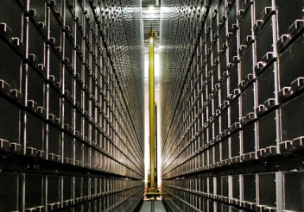
It will fill too!

Slide 4
Weeding – 3 webinars
Weeding: An Overview
Weeding: Communication and Outreach
Weeding: Special Collections and Library Reference Collections

Slide 5
Last Copy Project
The CARLI Last Copy Project seeks to preserve the last copy of monographs within the Illinois academic and research library community. This project allows any CARLI library that seeks to withdraw a "last copy" monograph to donate it to another CARLI library that will retain the title for resource sharing in Illinois.
Currently, the University of Illinois at Urbana-Champaign (UIUC) serves as the initial recipient of the monographs submitted to the Last Copy Project. Materials that the UIUC does not want or cannot house are offered to other interested Illinois research libraries.

Slide 6
Last Copy Project – Eligible Materials
Must be the last copy in Illinois, as confirmed through I-Share and through WorldCat
Must be bibliographically complete, with no missing volumes
Must be cataloged at least at the core (M) level
Must be completely free of mold, mildew, and insects
Materials may not include theses or dissertations filmed by ProQuest, retail catalogs, VHS tapes, ERIC fiche, or government documents. Libraries interested in donating Illinois state government documents should contact the Illinois State Library.

Slide 7
Webinar 1 - Weeding: an overview
Dr. Pamela Thomas, Technical Services Librarian, Illinois Central College
6 year program to remove over 53,000 titles using the CREW Method
Connie Lee, Technical Services Manager at Illinois College
2 year project removing print holdings that were duplicated online, included a faculty review shelf.
Bryan Deziel, Project Assistant at the Rebecca Crown Library at Dominican University
Non-traditional weeding project
Notes:
Illinois College: Like many libraries, Illinois College started weeding by removing print and microfilm holdings that were duplicated online (PDF) in collections such as JSTOR, EbscoHost and the
HathiTrust. Discarded materials were placed on faculty review shelves that hold up to 500 books. The library emails faculty, allowing a 4‐week review period, prior to withdrawal. Initially
a 2‐year window on circulation usage and a 5‐year window from the publication date were set. Later, this criterion was changed to 6‐years since the item’s acquisition, publication date or
circulation date.
Dominican The weeding review process began by asking some questions: What are these items? What project did they come from? Why were they pulled from the shelves? Are they duplicates? Are they in the catalog? Why were they pulled in the first place? What criteria should I to use to retain these items? There was an absence of statistics regarding the usage of these items. Half of the items were not in the catalog. Others were sitting on a shelf that was not accessible to patrons. 600‐700 items in question were divided into six units based on these categories: 1) duplicates, 2) theses, 3) children’s, 4) cataloging, 5) school media, and 6) miscellany.

Slide 8
Webinar 1 - Weeding: an overview
CREW Method in Ten Steps – Dr. Thomas
1. Make weeding a part of policy
2. Gather usage statistics of your library's collection
3. Build weeding into the year's work calendar
4. Gather the following materials on a book truck at the shelves to be analyzed
5. Study the area you will be weeding as a whole
6. Inventory the library's holdings
7. Check the pulled books against any standard indexes and bibliographic resources in
the library's reference collection or in databases available to patrons
8. Treat the books according to their slips: Bindery, Mending, Discard, Replacement,
Recycling
9. Replacement checking and ordering
10. Set up displays for low circulating, high quality books that would benefit from
Exposure.
https://www.tsl.state.tx.us/ld/pubs/crew/index.html
Notes:
Illinois College: Like many libraries, Illinois College started weeding by removing print and microfilm holdings that were duplicated online (PDF) in collections such as JSTOR, EbscoHost and the
HathiTrust. Discarded materials were placed on faculty review shelves that hold up to 500 books. The library emails faculty, allowing a 4‐week review period, prior to withdrawal. Initially
a 2‐year window on circulation usage and a 5‐year window from the publication date were set. Later, this criterion was changed to 6‐years since the item’s acquisition, publication date or
circulation date.
Dominican The weeding review process began by asking some questions: What are these items? What project did they come from? Why were they pulled from the shelves? Are they duplicates? Are they in the catalog? Why were they pulled in the first place? What criteria should I to use to retain these items? There was an absence of statistics regarding the usage of these items. Half of the items were not in the catalog. Others were sitting on a shelf that was not accessible to patrons. 600‐700 items in question were divided into six units based on these categories: 1) duplicates, 2) theses, 3) children’s, 4) cataloging, 5) school media, and 6) miscellany.

Slide 9
Webinar 2 – Communication and Outreach
Dr. Pamela Thomas, Technical Services Librarian, Illinois Central College
Communication and cooperation with faculty in weeding via spreedsheets and physical review shelves
Chad Buckley, Head of Collections at Illinois State University’s Milner Library
Weeding in response to repurpose ½ of the 3rd floor space for a cultural area. 38,000 items were selected for storage.

Slide 10
Webinar 3: Special Collections and Library Reference Collections
Matt Gorzalski, University Archivist, Southern Illinois University Carbodale
Weeding Special Collections and the need for reappraisal and deaccessioning.
Guidelines for Reappraisal and Deaccessioning, Society of American Archivist, 2012.
http://www2.archivists.org/sites/all/files/GuidelinesForReappraisalAndDeaccessioning‐May2012.pdf
Notes:
In Special Collections, weeding is considered part of the accessioning and processing
stage of managing collections. We weed our collections because it saves space and resources,
improves access to materials and reduces legal liabilities for the institution. Suggestions for
weeding collections include:
9 | P a g e
• Any materials that are not deemed of permanent value should be discarded.
• Be aware of potentially sensitive materials including personal financial materials, social
security numbers, FERPA, HIPAA and things of very personal in nature
• Retain no more than 2 to 3 copies of any item in the collection
• Establish guidelines of categories to consider weeding

Slide 11
Webinar 3: Special Collections and Library Reference Collections
3 speakers for reference collections
David Bottorff, Head of Collection Management, Regenstein Library, University of Chicago
William A McHugh, Principal Bibliographer, Coordinator for General and Interdisciplinary Service, Northwestern University
Geoffrey Morse, Coordinator for Humanities and Social Science, Northwestern University

Slide 12
Webinar 3: Special Collections and Library Reference Collections
Considerations for weeding the reference collection include:
Defining the reference collections and types of materials needs
Review current collection for e-equivalent or listing in Guide to Reference
Prioritize decisions and collaborate with subject specialists, reference librarians, and others if possible.
Lessons learned
Notes:
• Have a workflow in place on how to undertake a weeding project and document/track
all decisions made during the processing
• Build in flexibility for making these decisions
• Leverage technology—such as using scanners in the process
• Plan for change (decisions may need to be reconsidered) and document these
alternations
• Prepare for mistakes (they happen to everyone)
• Build in quality control and plan for clean‐up once project completed (there will
probably be inconsistencies

Slide 13
Weeding
Listings of selected weeding/deaccessioning policies from CARLI Member
Augustana College
Bradley University
College of DuPage
Illinois Institute of Technology
Millikin University
Northern Illinois University
Southern Illinois University Carbondale
University of Illinois at Urbana-Champaign
Notes:
No need to reinvent the wheel or go it alone. Start by reviewing the white paper, consider watching an appropriate webinar, reach out to presenters or colleagues throughout CARLI members.

Slide 14
Weeding
White Paper http://www.carli.illinois.edu/sites/files/files/2014CollectionManagementCommWeedingWhitePaper.pdf
Webinar
http://www.carli.illinois.edu/products-services/collections-management/collections-webinars

